Slide 1
Memory Hierarchy Design Advances
05
Kai Bu
kaibu@zju.edu.cn
http://list.zju.edu.cn/kaibu/comparch2021

Slide 2
ten advanced optimizations
Notes:
Next, we’ll get to know ten advanced optimizations.
Chapter 2.3
Proceed with Chapter 2.3 instead of Chapter 2.2 for tightly-coupled discussion of cache optimizations

Slide 3
Ten Advanced Cache Opts
Goal: average memory access time
Metrics to reduce/optimize
hit time
miss rate
miss penalty
cache bandwidth
power consumption
Notes:
Their goal is still to reduce average memory access time.
Besides hit time, miss rate, and miss penalty, they also try to increase cache bandwidth and reduce power consumption.

Slide 4
Ten Advanced Cache Opts
Reduce hit time
small and simple first-level caches;
way prediction;
decrease power;
Increase cache bandwidth
pipelined/multibanked/nonblocking cache;
Reduce miss penalty
critical word first;
merging write buffers;
Reduce miss rate
compiler optimizations; decrease power;
Reduce miss penalty/rate via parallelism
hardware/compiler prefetching; increase power;
Notes:
Here’s an overview of which optimizations to enhance which metrics.
Now let’s discuss each one in detail.

Slide 5
Opt #1: Small and Simple First-Level Caches
Small size
support a fast clock cycle
reduce power
Lower associativity
reduce both hit time and power
(direct-mapped caches can overlap the tag check with the transmission of the data,
there’s only one piece of data for each index)
Notes:
The first optimization advocates small and simple first-level caches.
When the cache is small enough, it delivers fast hit time to support a fast clock cycle. Meanwhile, it reduces power consumption.
By simple, it advocates lower associativity. This also reduces both hit time and power.
The critical timing path in a cache hit is the three-step process of addressing the tag memory using the index portion of the address, comparing the read tag value to the address, and setting the multiplexor to choose the correct data item if the cache is set associative. Direct-mapped caches can overlap the tag check with the transmis- sion of the data, effectively reducing hit time. Furthermore, lower levels of associa- tivity will usually reduce power because fewer cache lines must be accessed.

Slide 6
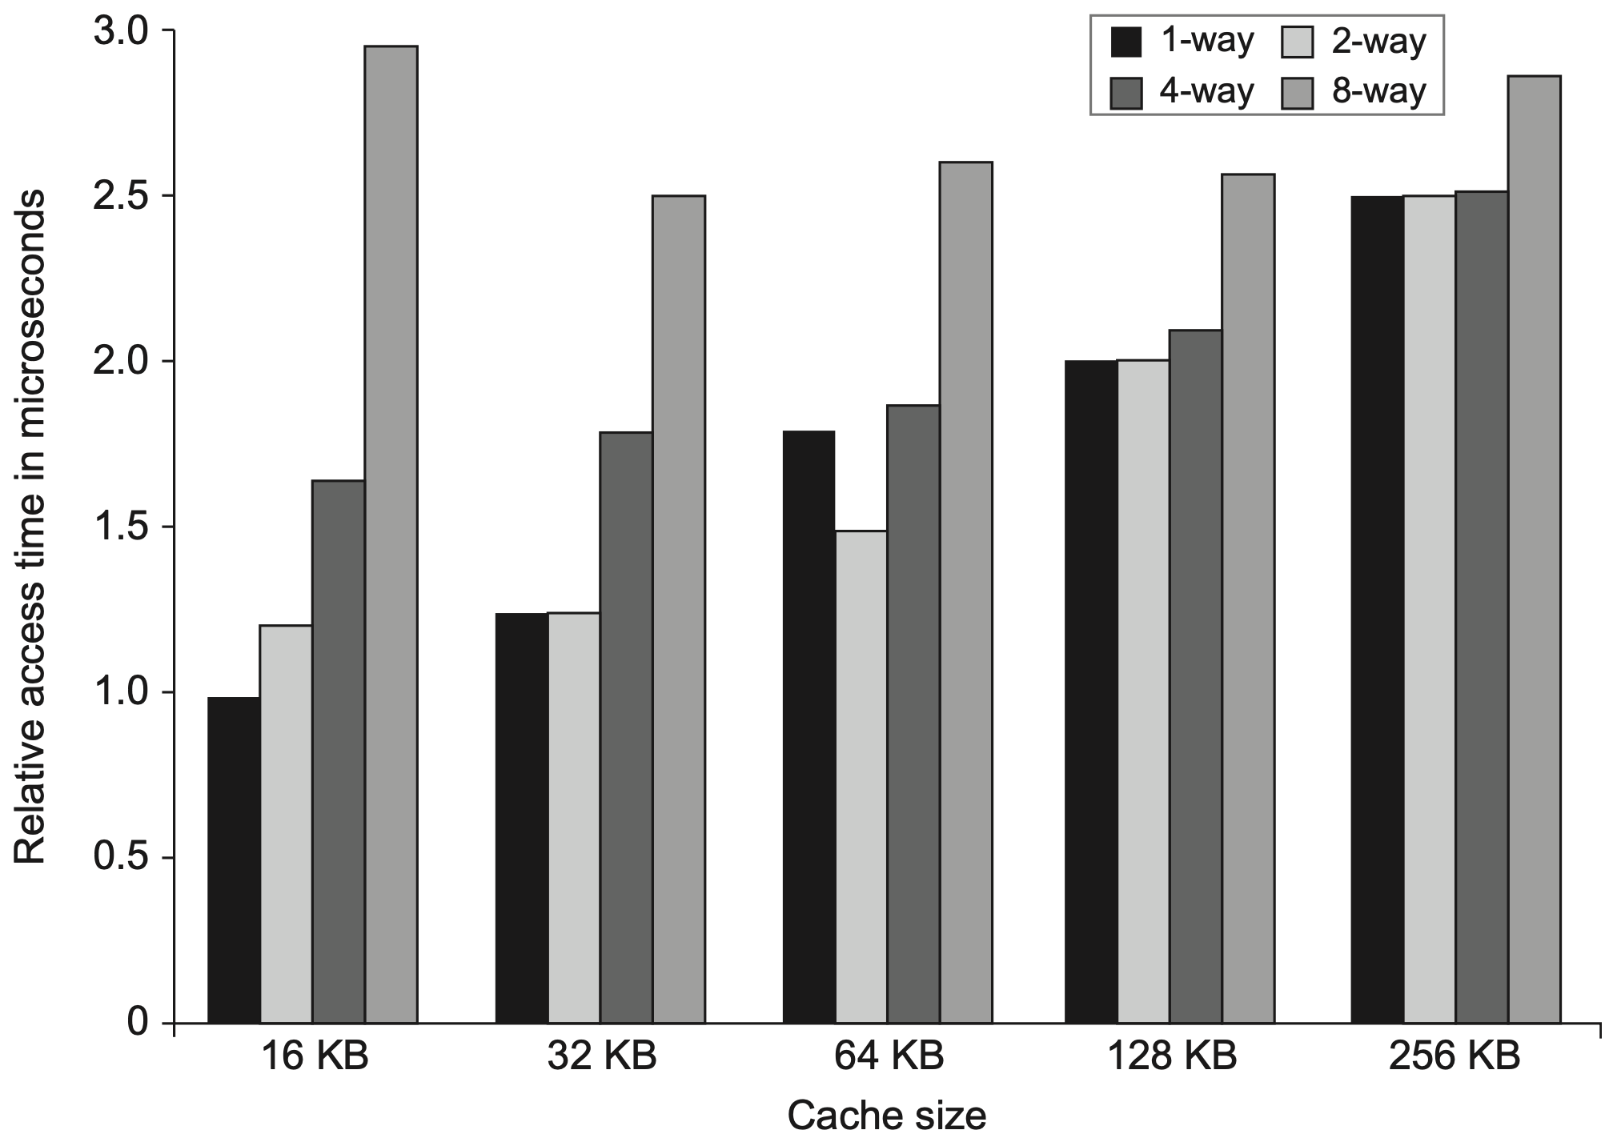
Opt #1: Small and Simple First-Level Caches
Reduce hit time
Notes:
Smaller caches – faster
Lower associativity
Figure 2.8 shows the estimated impact on hit time as cache size and associativity are varied. Depending on cache size, for these parameters, the model suggests that the hit time for direct mapped is slightly faster than two-way set associative and that two-way set associative is 1.2 times as fast as four-way and four-way is 1.4 times as fast as eight-way. Of course, these estimates depend on technology as well as the size of the cache, and CACTI must be carefully aligned with the technology; Figure 2.8 shows the relative tradeoffs for one technology.
Figure 2.8 Relative access times generally increase as cache size and associativity are increased. These data come from the CACTI model 6.5 by Tarjan et al. (2005). The data assume typical embedded SRAM technology, a single bank, and 64-byte blocks. The assumptions about cache layout and the complex trade-offs between inter- connect delays (that depend on the size of a cache block being accessed) and the cost of tag checks and multiplexing lead to results that are occasionally surprising, such as the lower access time for a 64 KiB with two-way set associativity versus direct mapping. Sim- ilarly, the results with eight-way set associativity generate unusual behavior as cache size is increased. Because such observations are highly dependent on technology and detailed design assumptions, tools such as CACTI serve to reduce the search space. These results are relative; nonetheless, they are likely to shift as we move to more recent and denser semiconductor technologies.

Slide 7
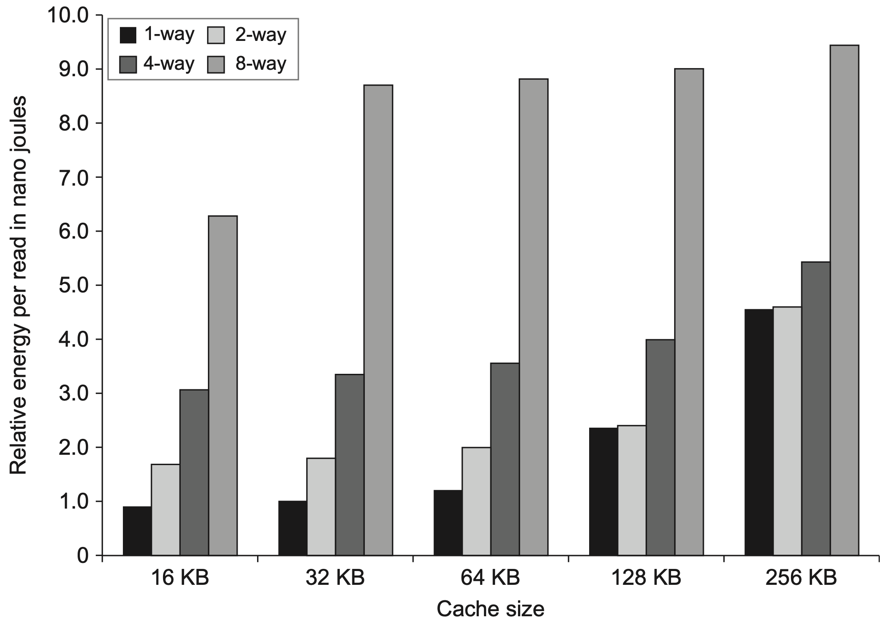
Opt #1: Small and Simple First-Level Caches
Reduce power
Notes:
Figure 2.9 Energy consumption per read increases as cache size and associativity are increased. As in the previous figure, CACTI is used for the modeling with the same technology parameters. The large penalty for eight-way set associative caches is due to the cost of reading out eight tags and the corresponding data in parallel.
Energy consumption is also a consideration in choosing both the cache size and associativity, as Figure 2.9 shows. The energy cost of higher associativity ranges from more than a factor of 2 to negligible in caches of 128 or 256 KiB when going from direct mapped to two-way set associative.
As energy consumption has become critical, designers have focused on ways to reduce the energy needed for cache access. In addition to associativity, the other key factor in determining the energy used in a cache access is the number of blocks in the cache because it determines the number of “rows” that are accessed. A designer could reduce the number of rows by increasing the block size (holding total cache size constant), but this could increase the miss rate, especially in smaller L1 caches.

Slide 8
Opt #2: Way Prediction
Reduce conflict misses and hit time
Way prediction
block predictor bits are added to each block to predict the way/block within the set of the next cache access
the multiplexor is set early to select the desired block;
only a single tag comparison is performed in parallel with cache reading;
a miss results in checking the other blocks for matches in the next clock cycle;
Notes:
An extended form of way prediction can also be used to reduce power con- sumption by using the way prediction bits to decide which cache block to actu- ally access (the way prediction bits are essentially extra address bits); this approach, which might be called way selection, saves power when the way pre- diction is correct but adds significant time on a way misprediction, since the access, not just the tag match and selection, must be repeated. Such an optimiza- tion is likely to make sense only in low-power processors.

Slide 9
Opt #3: Pipelined Access
Increase cache bandwidth
Higher latency
Greater penalty on mispredicted branches and more clock cycles between issuing load and using data

Slide 10
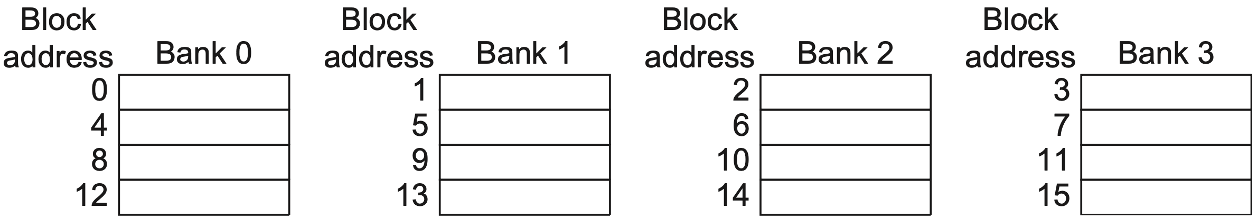
Opt #3: Multibanked Caches
Increase cache bandwidth
Divide cache into independent banks that support simultaneous accesses
Sequential interleaving
spread the addresses of blocks sequentially across the banks
Notes:
Clearly, banking works best when the accesses naturally spread themselves across the banks, so the mapping of addresses to banks affects the behavior of the memory system. A simple mapping that works well is to spread the addresses of the block sequentially across the banks, called sequential interleaving. For example, if there are four banks, bank 0 has all blocks whose address modulo 4 is 0, bank 1 has all blocks whose address modulo 4 is 1, and so on.

Slide 11
Opt #4: Nonblocking Caches
Increase cache bandwidth
Nonblocking/lockup-free cache
leverage out-of-order execution
allows data cache to continue to supply cache hits during a miss;
hit under miss;
miss under miss;
hit under multiple misses;
Notes:
More details in next chapter:
When a miss returns, the processor must know which load or store caused the miss, so that instruction can now go forward; and it must know where in the cache the data should be placed (as well as the setting of tags for that block). In recent processors, this information is kept in a set of registers, typically called the Miss Status Handling Registers (MSHRs). If we allow n outstanding misses, there will be n MSHRs, each holding the information about where a miss goes in the cache and the value of any tag bits for that miss, as well as the information indicating which load or store caused the miss (in the next chapter, you will see how this is tracked). Thus, when a miss occurs, we allocate an MSHR for handling that miss, enter the appropriate information about the miss, and tag the memory request with the index of the MSHR. The memory system uses that tag when it returns the data, allowing the cache system to transfer the data and tag information to the appropri- ate cache block and “notify” the load or store that generated the miss that the data is now available and that it can resume operation. Nonblocking caches clearly require extra logic and thus have some cost in energy. It is difficult, however, to assess their energy costs exactly because they may reduce stall time, thereby decreasing execution time and resulting energy consumption.

Slide 12
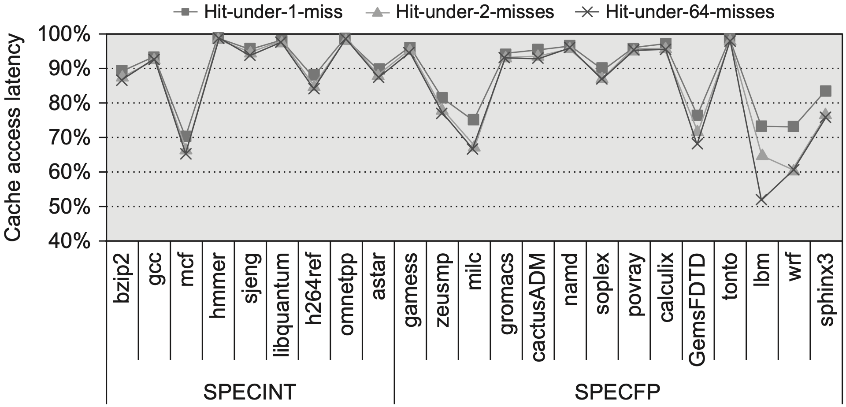
Opt #4: Nonblocking Caches
Performance improvement by allowing 1, 2, and 64 hits under a cache miss
1
2
64
Notes:
Figure 2.11 The effectiveness of a nonblocking cache is evaluated by allowing 1, 2, or 64 hits under a cache miss with 9 SPECINT (on the left) and 9 SPECFP (on the right) benchmarks. The data memory system modeled after the Intel i7 consists of a 32 KiB L1 cache with a four-cycle access latency. The L2 cache (shared with instructions) is 256 KiB with a 10-clock cycle access latency. The L3 is 2 MiB and a 36-cycle access latency. All the caches are eight-way set associative and have a 64-byte block size. Allowing one hit under miss reduces the miss penalty by 9% for the integer benchmarks and 12.5% for the floating point. Allowing a second hit improves these results to 10% and 16%, and allowing 64 results in little additional improvement.

Slide 13
Opt #4: Nonblocking Caches
Integer benchmarks: 9% Floating-point benchmarks: 12.5%
1
2
64
Notes:
Figure 2.11 The effectiveness of a nonblocking cache is evaluated by allowing 1, 2, or 64 hits under a cache miss with 9 SPECINT (on the left) and 9 SPECFP (on the right) benchmarks. The data memory system modeled after the Intel i7 consists of a 32 KiB L1 cache with a four-cycle access latency. The L2 cache (shared with instructions) is 256 KiB with a 10-clock cycle access latency. The L3 is 2 MiB and a 36-cycle access latency. All the caches are eight-way set associative and have a 64-byte block size. Allowing one hit under miss reduces the miss penalty by 9% for the integer benchmarks and 12.5% for the floating point. Allowing a second hit improves these results to 10% and 16%, and allowing 64 results in little additional improvement.

Slide 14
Opt #4: Nonblocking Caches
Integer benchmarks: 10% Floating-point benchmarks: 16%
1
2
64
Notes:
Figure 2.11 The effectiveness of a nonblocking cache is evaluated by allowing 1, 2, or 64 hits under a cache miss with 9 SPECINT (on the left) and 9 SPECFP (on the right) benchmarks. The data memory system modeled after the Intel i7 consists of a 32 KiB L1 cache with a four-cycle access latency. The L2 cache (shared with instructions) is 256 KiB with a 10-clock cycle access latency. The L3 is 2 MiB and a 36-cycle access latency. All the caches are eight-way set associative and have a 64-byte block size. Allowing one hit under miss reduces the miss penalty by 9% for the integer benchmarks and 12.5% for the floating point. Allowing a second hit improves these results to 10% and 16%, and allowing 64 results in little additional improvement.

Slide 15
Opt #4: Nonblocking Caches
Integer benchmarks: ~10% Floating-point benchmarks: ~16%
1
2
64
Notes:
Figure 2.11 The effectiveness of a nonblocking cache is evaluated by allowing 1, 2, or 64 hits under a cache miss with 9 SPECINT (on the left) and 9 SPECFP (on the right) benchmarks. The data memory system modeled after the Intel i7 consists of a 32 KiB L1 cache with a four-cycle access latency. The L2 cache (shared with instructions) is 256 KiB with a 10-clock cycle access latency. The L3 is 2 MiB and a 36-cycle access latency. All the caches are eight-way set associative and have a 64-byte block size. Allowing one hit under miss reduces the miss penalty by 9% for the integer benchmarks and 12.5% for the floating point. Allowing a second hit improves these results to 10% and 16%, and allowing 64 results in little additional improvement.

Slide 16
Opt #4: Nonblocking Caches
Example: 32 KiB L1 data cache miss penalty to L2 is 10 cycles miss rates:
Two-way set associativity or hit under one miss improves more?
 | direct-mapped | 2-way set assoc.
integer | 3.5% | 3.2%
flating-point | 5.2% | 4.9%
Notes:
Figure 2.11 The effectiveness of a nonblocking cache is evaluated by allowing 1, 2, or 64 hits under a cache miss with 9 SPECINT (on the left) and 9 SPECFP (on the right) benchmarks. The data memory system modeled after the Intel i7 consists of a 32 KiB L1 cache with a four-cycle access latency. The L2 cache (shared with instructions) is 256 KiB with a 10-clock cycle access latency. The L3 is 2 MiB and a 36-cycle access latency. All the caches are eight-way set associative and have a 64-byte block size. Allowing one hit under miss reduces the miss penalty by 9% for the integer benchmarks and 12.5% for the floating point. Allowing a second hit improves these results to 10% and 16%, and allowing 64 results in little additional improvement.

Slide 17
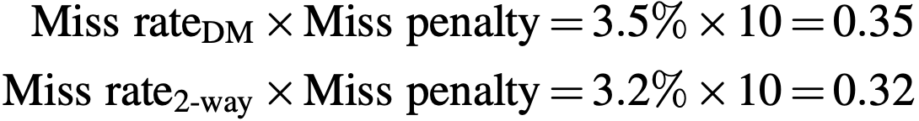
Opt #4: Nonblocking Caches
Example: 32 KiB L1 data cache miss penalty to L2 is 10 cycles miss rates:
Two-way set associativity or hit under one miss improves more? 0.32/0.35 = 91% → 9% improvement
 | direct-mapped | 2-way set assoc.
integer | 3.5% | 3.2%
flating-point | 5.2% | 4.9%
Notes:
Figure 2.11 The effectiveness of a nonblocking cache is evaluated by allowing 1, 2, or 64 hits under a cache miss with 9 SPECINT (on the left) and 9 SPECFP (on the right) benchmarks. The data memory system modeled after the Intel i7 consists of a 32 KiB L1 cache with a four-cycle access latency. The L2 cache (shared with instructions) is 256 KiB with a 10-clock cycle access latency. The L3 is 2 MiB and a 36-cycle access latency. All the caches are eight-way set associative and have a 64-byte block size. Allowing one hit under miss reduces the miss penalty by 9% for the integer benchmarks and 12.5% for the floating point. Allowing a second hit improves these results to 10% and 16%, and allowing 64 results in little additional improvement.

Slide 18
Opt #4: Nonblocking Caches
Integer benchmarks: 9% Floating-point benchmarks: 12.5%
1
2
64
Notes:
Figure 2.11 The effectiveness of a nonblocking cache is evaluated by allowing 1, 2, or 64 hits under a cache miss with 9 SPECINT (on the left) and 9 SPECFP (on the right) benchmarks. The data memory system modeled after the Intel i7 consists of a 32 KiB L1 cache with a four-cycle access latency. The L2 cache (shared with instructions) is 256 KiB with a 10-clock cycle access latency. The L3 is 2 MiB and a 36-cycle access latency. All the caches are eight-way set associative and have a 64-byte block size. Allowing one hit under miss reduces the miss penalty by 9% for the integer benchmarks and 12.5% for the floating point. Allowing a second hit improves these results to 10% and 16%, and allowing 64 results in little additional improvement.

Slide 19
Opt #4: Nonblocking Caches
Example: 32 KiB L1 data cache miss penalty to L2 is 10 cycles miss rates:
Two-way set associativity or hit under one miss improves more? about equal 0.32/0.35 = 91% → 9% improvement
 | direct-mapped | 2-way set assoc.
integer | 3.5% | 3.2%
flating-point | 5.2% | 4.9%
Notes:
Figure 2.11 The effectiveness of a nonblocking cache is evaluated by allowing 1, 2, or 64 hits under a cache miss with 9 SPECINT (on the left) and 9 SPECFP (on the right) benchmarks. The data memory system modeled after the Intel i7 consists of a 32 KiB L1 cache with a four-cycle access latency. The L2 cache (shared with instructions) is 256 KiB with a 10-clock cycle access latency. The L3 is 2 MiB and a 36-cycle access latency. All the caches are eight-way set associative and have a 64-byte block size. Allowing one hit under miss reduces the miss penalty by 9% for the integer benchmarks and 12.5% for the floating point. Allowing a second hit improves these results to 10% and 16%, and allowing 64 results in little additional improvement.

Slide 20
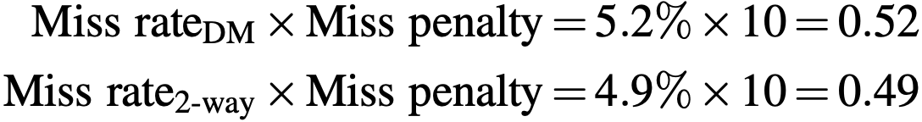
Opt #4: Nonblocking Caches
Example: 32 KiB L1 data cache miss penalty to L2 is 10 cycles miss rates:
Two-way set associativity or hit under one miss improves more? 0.49/0.52 = 94% → 6% improvement
 | direct-mapped | 2-way set assoc.
integer | 3.5% | 3.2%
flating-point | 5.2% | 4.9%
Notes:
Figure 2.11 The effectiveness of a nonblocking cache is evaluated by allowing 1, 2, or 64 hits under a cache miss with 9 SPECINT (on the left) and 9 SPECFP (on the right) benchmarks. The data memory system modeled after the Intel i7 consists of a 32 KiB L1 cache with a four-cycle access latency. The L2 cache (shared with instructions) is 256 KiB with a 10-clock cycle access latency. The L3 is 2 MiB and a 36-cycle access latency. All the caches are eight-way set associative and have a 64-byte block size. Allowing one hit under miss reduces the miss penalty by 9% for the integer benchmarks and 12.5% for the floating point. Allowing a second hit improves these results to 10% and 16%, and allowing 64 results in little additional improvement.

Slide 21
Opt #4: Nonblocking Caches
Integer benchmarks: 9% Floating-point benchmarks: 12.5%
1
2
64
Notes:
Figure 2.11 The effectiveness of a nonblocking cache is evaluated by allowing 1, 2, or 64 hits under a cache miss with 9 SPECINT (on the left) and 9 SPECFP (on the right) benchmarks. The data memory system modeled after the Intel i7 consists of a 32 KiB L1 cache with a four-cycle access latency. The L2 cache (shared with instructions) is 256 KiB with a 10-clock cycle access latency. The L3 is 2 MiB and a 36-cycle access latency. All the caches are eight-way set associative and have a 64-byte block size. Allowing one hit under miss reduces the miss penalty by 9% for the integer benchmarks and 12.5% for the floating point. Allowing a second hit improves these results to 10% and 16%, and allowing 64 results in little additional improvement.

Slide 22
Opt #4: Nonblocking Caches
Example: 32 KiB L1 data cache miss penalty to L2 is 10 cycles miss rates:
Two-way set associativity or hit under one miss improves more? 0.49/0.52 = 94% → 6% improvement
 | direct-mapped | 2-way set assoc.
integer | 3.5% | 3.2%
flating-point | 5.2% | 4.9%
Notes:
Figure 2.11 The effectiveness of a nonblocking cache is evaluated by allowing 1, 2, or 64 hits under a cache miss with 9 SPECINT (on the left) and 9 SPECFP (on the right) benchmarks. The data memory system modeled after the Intel i7 consists of a 32 KiB L1 cache with a four-cycle access latency. The L2 cache (shared with instructions) is 256 KiB with a 10-clock cycle access latency. The L3 is 2 MiB and a 36-cycle access latency. All the caches are eight-way set associative and have a 64-byte block size. Allowing one hit under miss reduces the miss penalty by 9% for the integer benchmarks and 12.5% for the floating point. Allowing a second hit improves these results to 10% and 16%, and allowing 64 results in little additional improvement.

Slide 23
Opt #5: Critical Word First
Reduce miss penalty
Motivation: processor normally needs just one word of the block at a time
Critical word first
request the missed word first from the memory and send it to the processor as soon as it arrives;
processor continues execution while filling the rest of the words in the block

Slide 24
Opt #5: Early Restart
Reduce miss penalty
Motivation: processor normally needs just one word of the block at a time
Early restart
fetch the words in normal order,
as soon as the requested word arrives send it to the processor
let the processor continue execution

Slide 25
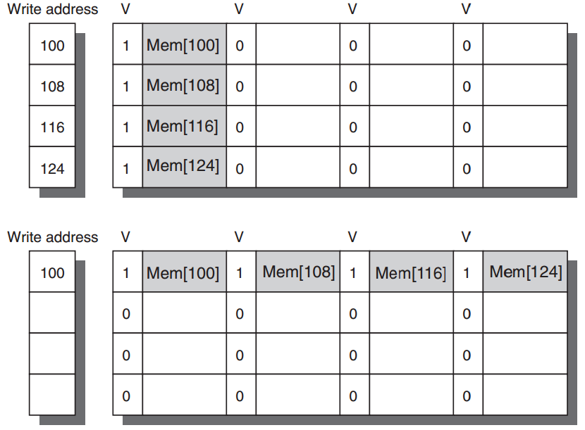
Opt #6: Merging Write Buffer
Reduce miss penalty
Write merging merges four entries (with sequential addresses)
into a single buffer entry
Notes:
Figure2.12 In this illustration of write merging, the write buffer on top does not use write merging while the write buffer on the bottom does. The four writes are merged into a single buffer entry with write merging; without it, the buffer is full even though three-fourths of each entry is wasted. The buffer has four entries, and each entry holds four 64-bit words. The address for each entry is on the left, with a valid bit (V) indicating whether the next sequential 8 bytes in this entry are occupied. (Without write merging, the words to the right in the upper part of the figure would be used only for instructions that wrote multiple words at the same time.)

Slide 26
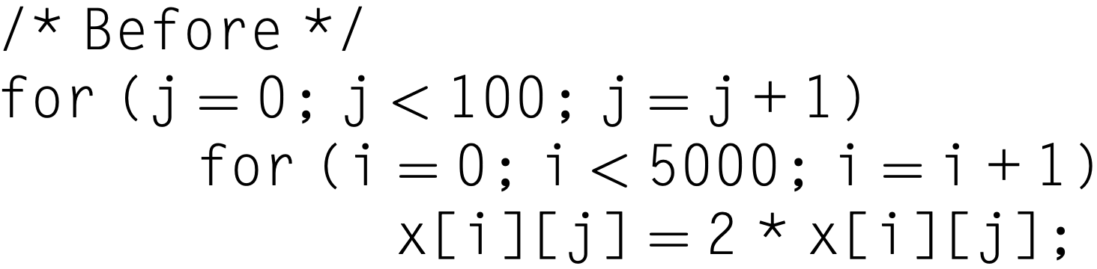
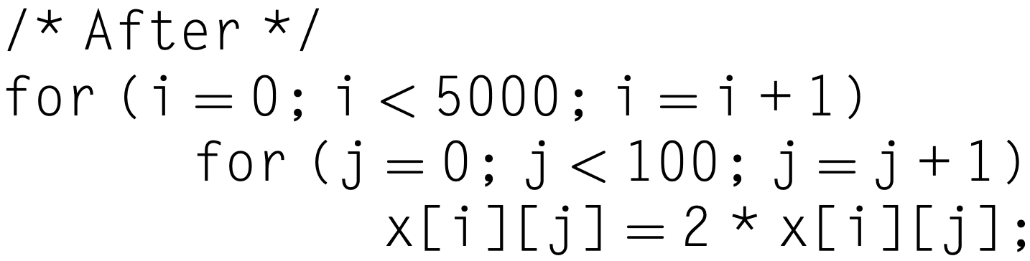
Opt #7: Compiler Optimization
Reduce miss rates, w/o hw changes
Tech 1: Loop interchange
exchange the nesting of the loops to make the code access the data in the order in which they are stored
x[i,j] and x[i,j+1] are adjacent
Notes:
Without hardware changes

Slide 27
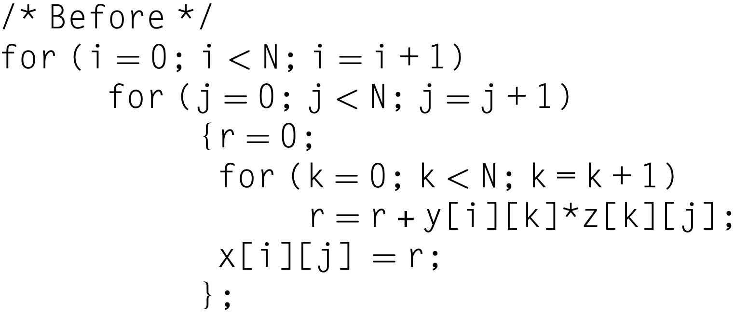
Opt #7: Compiler Optimization
Reduce miss rates, w/o hw changes
Example: matrix multiplication
x = y*z; both row&column accesses
Notes:
matrix multiplication as example
The two inner loops read all N-by-N elements of z, read the same N elements in a row of y repeatedly, and write one row of N elements of x.

Slide 28
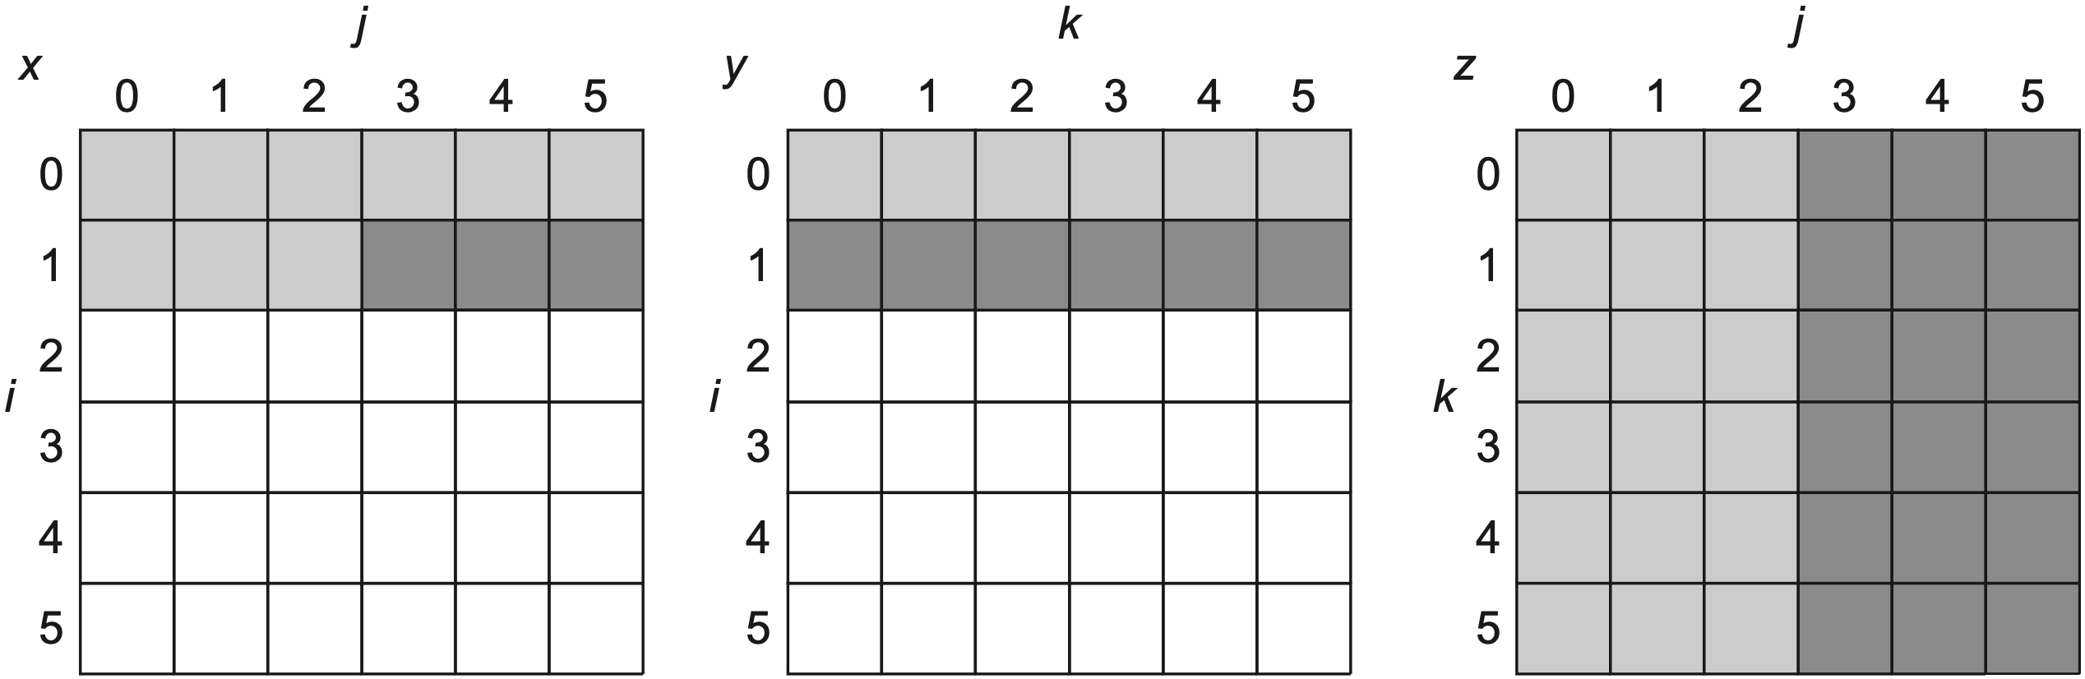
Opt #7: Compiler Optimization
Reduce miss rates, w/o hw changes
Tech 2: Blocking
x = y*z; both row&column accesses
before
older access
newer access
not yet touched
Notes:
This optimization tries to reduce misses via improved temporal locality. We are
again dealing with multiple arrays, with some arrays accessed by rows and some
by columns. Storing the arrays row by row (row major order) or column by column
(column major order) does not solve the problem because both rows and
columns are used in every iteration of the loop. Such orthogonal accesses mean
the transformations such as loop interchange are not helpful.
Instead of operating on entire rows or columns of an array, blocked algorithms
operate on submatrices or blocks. The goal is to maximize accesses to the data
loaded into the cache before the data are replaced.

Slide 29
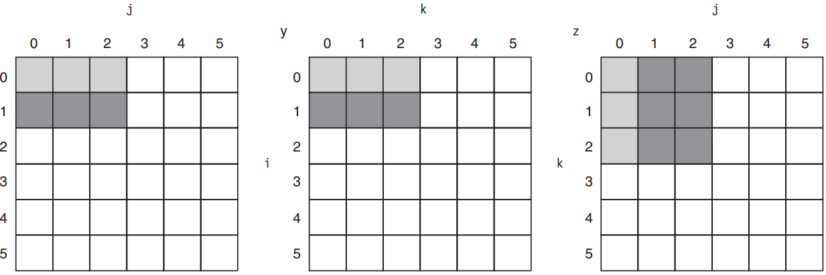
Opt #7: Compiler Optimization
Reduce miss rates, w/o hw changes
Tech 2: Blocking
x = y*z; compute using submatrices
after; maximize accesses to loaded data before they are replaced
Notes:
More in textbook;

Slide 30
Opt #7: Compiler Optimization
Reduce miss rates, w/o hw changes
Tech 2: Blocking
x = y*z; compute using blocks
after; maximize accesses to loaded data before they are replaced
Notes:
More in textbook;

Slide 31
Opt #8: Hardware Prefetching
Reduce miss penalty/rate
Prefetch items before the processor requests them, into the cache or external buffer

Slide 32
Opt #8: Hardware Prefetching
Instruction prefetch
fetch two blocks on a miss:
requested one into cache
next consecutive one into instruction stream buffer
If requested block is in stream buffer:
cancel the original cache request
read the block from stream buffer
issue next prefetch request

Slide 33
Opt #8: Hardware Prefetching
Instruction prefetch
fetch two blocks on a miss:
requested one into cache
next consecutive one into instruction stream buffer
Similar Data prefetch approaches

Slide 34
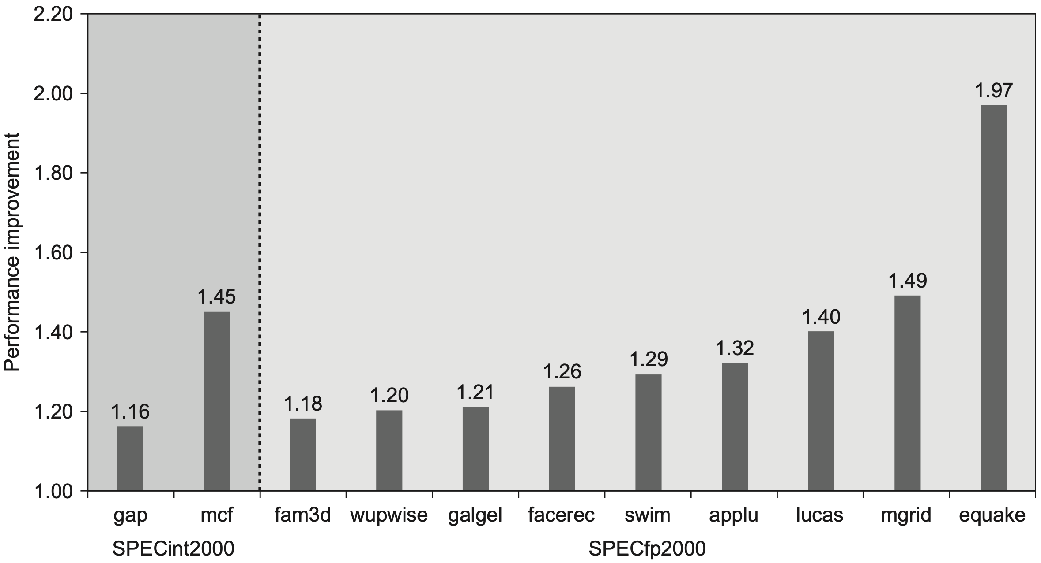
Opt #8: Hardware Prefetching
Notes:
Figure 2.15 Speedup because of hardware prefetching on Intel Pentium 4 with hardware prefetching turned on for 2 of 12 SPECint2000 benchmarks and 9 of 14 SPECfp2000 benchmarks. Only the programs that benefit the most from prefetching are shown; prefetching speeds up the missing 15 SPECCPU benchmarks by less than 15% (Boggs et al., 2004).

Slide 35
Opt #9: Compiler Prefetching
Reduce miss penalty/rate
Compiler to insert prefetch instructions to request data before the processor needs it
Register prefetch
load the value into a register
Cache prefetch
load data into the cache

Slide 36
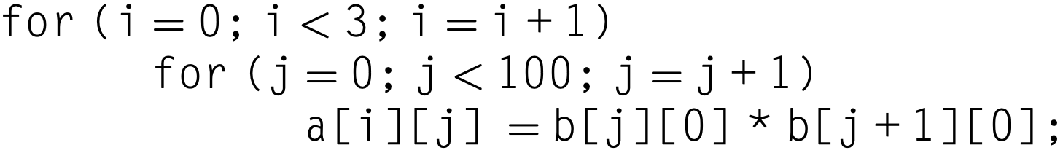
Opt #9: Compiler Prefetching
Example: 251 misses
16-byte blocks;
8-byte elements for a and b;
write-back strategy;
a[0][0] miss, copy both a[0][0],a[0][1] as one block contains 16/8 = 2;
so for a: 3 x (100/2) = 150 misses
b[0][0] – b[100][0]: 101 misses

Slide 37
Opt #9: Compiler Prefetching
Example: 251 misses
16-byte blocks;
8-byte elements for a and b;
write-back strategy;
a[0][0] miss, copy both a[0][0],a[0][1] as one block contains 16/8 = 2;
how many misses?

Slide 38
Opt #9: Compiler Prefetching
Example: 251 misses
16-byte blocks;
8-byte elements for a and b;
write-back strategy;
a[0][0] miss, copy both a[0][0],a[0][1] as one block contains 16/8 = 2;
so for a: 3 x (100/2) = 150 misses
b[0][0] – b[100][0]: 101 misses

Slide 39
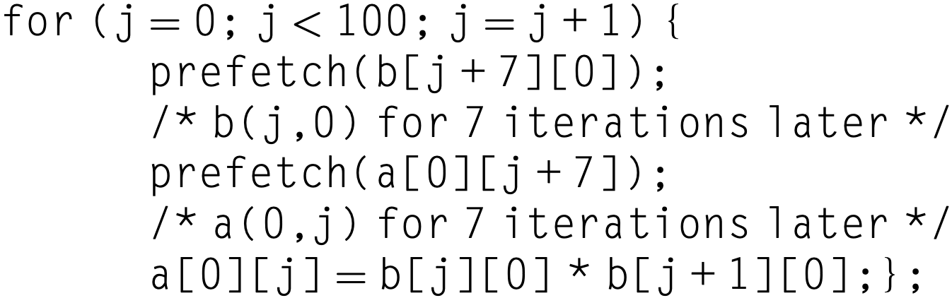
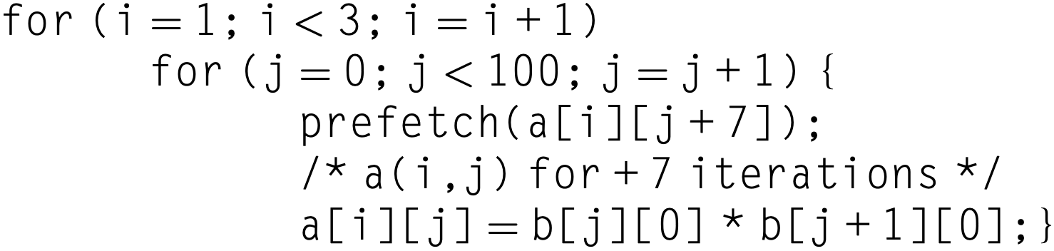
Opt #9: Compiler Prefetching
Example: 19 misses by prefetching
?
7 misses: b[0][0] – b[6][0]
4 misses: 1/2 of a[0][0] – a[0][6]
4 misses: a[1][0] – a[1][6]
4 misses: a[2][0] – a[2][6]

Slide 40
Opt #9: Compiler Prefetching
Example: 19 misses by prefetching
7 misses: b[0][0] – b[6][0]
4 misses: 1/2 of a[0][0] – a[0][6]
4 misses: a[1][0] – a[1][6]
4 misses: a[2][0] – a[2][6]

Slide 41
Opt #9: Compiler Prefetching
Example
original loop: 7 CC per iteration
first prefetch loop: 9 CC per iteration
second prefetch loop: 8 CC per iteration
cache miss: 100 CC
Question
calculate the time saved by prefetching
assuming prefetches are completely overlapped with the rest of execution
Notes:
Calculate the time saved in the preceding example. Ignore instruction cache misses and assume there are no conflict or capacity misses in the data cache. Assume that prefetches can overlap with each other and with cache misses, thereby transferring at the maximum memory bandwidth. Here are the key loop times ignoring cache misses: the original loop takes 7 clock cycles per iteration, the first prefetch loop takes 9 clock cycles per iteration, and the second prefetch loop takes 8 clock cycles per iteration (including the overhead of the outer for loop). A miss takes 100 clock cycles.

Slide 42
Opt #9: Compiler Prefetching
Example
3 x 100 = 300 iterations
251 misses

Slide 43
Opt #9: Compiler Prefetching
Example
3 x 100 = 300 iterations
251 misses
300 x 7 + 251 x 100 = 27200 CC

Slide 44
Opt #9: Compiler Prefetching
Example
100 iterations
11 misses
200 iterations
8 misses

Slide 45
Opt #9: Compiler Prefetching
Example
900 CC
1100 CC
1600 CC
800 CC

Slide 46
Opt #9: Compiler Prefetching
Example: 4400 clock cycles
900 CC
1100 CC
1600 CC
800 CC

Slide 47
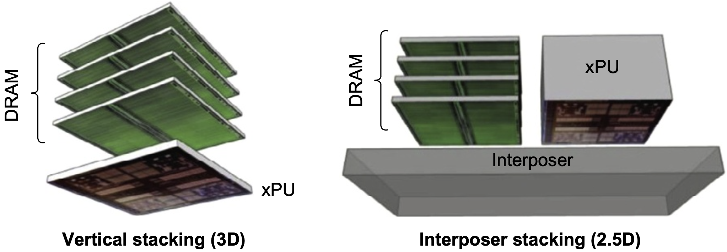
Opt #10: HBM
Use HBM as L4 cache
Notes:
New to 6th Edition

Slide 48
Opt #10: HBM
Use HBM as L4 cache
Potentially large volume of tags
given 1 GiB L4 cache
64B block size → 96 MiB of tags
4 KiB block size → 1 MiB of tags
Notes:
New to 6th Edition

Slide 49
Opt #10: HBM
Use HBM as L4 cache
Potentially large volume of tags
given 1 GiB L4 cache
64B block size → 96 MiB of tags
4 KiB block size → 1 MiB of tags
Require two accesses to DRAM for each L4 access
one for tags
one for data
Notes:
New to 6th Edition

Slide 50
Opt #10: HBM
Optimization 1: place tags and data in the same row
albeit a long time to open a row
1/3 time to access an opened row;
access tag first, then data if tag hit;
Notes:
New to 6th Edition

Slide 51
Opt #10: HBM
Optimization 2: alloy cache
mold tag and data together
direct mapped cache structure
single HBM cycle for access: directly index HBM cache and do a burst transfer of both tag and data
Notes:
New to 6th Edition

Slide 52
Opt #10: HBM
HBM miss requires two DRAM accesses
one to get the initial tag
one to get data in the main memory
Speed up miss detection to reduce miss time
use a map to track where a block is present in cache
use memory access predictor to predict likely misses using access history
Notes:
New to 6th Edition

Slide 53
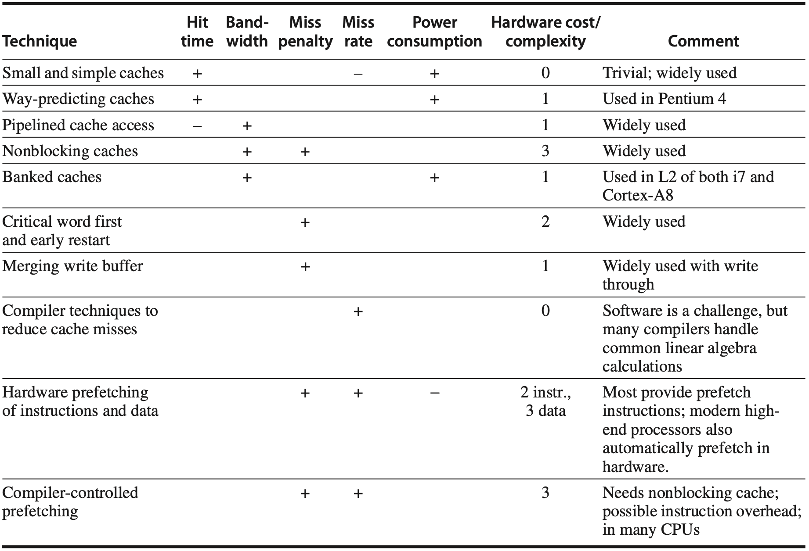
Summary of Cache Opt
Notes:
Figure 2.18 Summary of 10 advanced cache optimizations showing impact on cache performance, power consumption, and complexity. Although generally a technique helps only one factor, prefetching can reduce misses if donesufficientlyearly;ifnot,itcanreducemisspenalty.+meansthatthetechniqueimprovesthefactor,% means it hurts that factor, and blank means it has no impact. The complexity measure is subjective, with 0 being the easiest and 3 being a challenge.

Slide 54
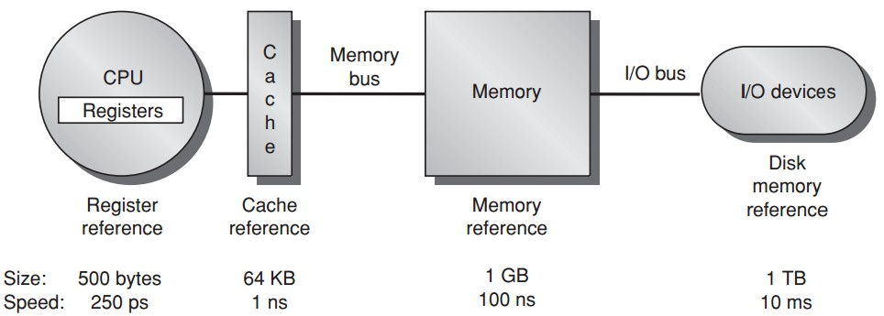
Optimization
√
√

Slide 55
performance so far

Slide 56
on to protection
Notes:
Security and privacy are two of the most vexing challenges for information tech- nology in 2011. Electronic burglaries, often involving lists of credit card num- bers, are announced regularly, and it’s widely believed that many more go unreported. Hence, both researchers and practitioners are looking for new ways to make computing systems more secure. Although protecting information is not limited to hardware, in our view real security and privacy will likely involve innovation in computer architecture as well as in systems software.
This section starts with a review of the architecture support for protecting processes from each other via virtual memory. It then describes the added protec- tion provided from virtual machines, the architecture requirements of virtual machines, and the performance of a virtual machine.

Slide 57
on to protection
via virtual memory
Notes:
Security and privacy are two of the most vexing challenges for information tech- nology in 2011. Electronic burglaries, often involving lists of credit card num- bers, are announced regularly, and it’s widely believed that many more go unreported. Hence, both researchers and practitioners are looking for new ways to make computing systems more secure. Although protecting information is not limited to hardware, in our view real security and privacy will likely involve innovation in computer architecture as well as in systems software.
This section starts with a review of the architecture support for protecting processes from each other via virtual memory. It then describes the added protec- tion provided from virtual machines, the architecture requirements of virtual machines, and the performance of a virtual machine.

Slide 58
Prior Virtual Memory
Main/Physical Memory
Contiguous allocation
Direct memory access
allocated
Process A
Process B
allocated
Notes:
If we directly map process address space to physical memory address, we need to follow contiguous allocation like this.
Then each process can use direct memory access using physical memory address.

Slide 59
Prior Virtual Memory
Main/Physical Memory
efficiency?
used
Process A
Process B
used
Notes:
One possible limitation of such direct memory access is low memory efficiency.
As we can see, at certain time instants, a process uses way less memory than it is allocated for.

Slide 60
Prior Virtual Memory
Main/Physical Memory
protection?
used
Process A
Process B
used
Notes:
Another limitation is lack of memory protection to prevent a process from accessing memory allocated for other processes.

Slide 61
Prior Virtual Memory
Main/Physical Memory
Easier/flexible memory management
Virtual memory
used
used
Process A
Process B
used
used
Notes:
To address the above limitations, virtual memory introduces an indirect mapping from the memory address processes use to the physical memory address where data actually locates.

Slide 62
Prior Virtual Memory
Main/Physical Memory
Share a smaller amount of physical memory among many processes
Virtual memory
used
used
Process A
Process B
used
used
Notes:
Each process still thinks that the same amount of memory space is allocated for it;
But in practical, not all data need to be pre-loaded into memory and processed data could be evicted from memory.
This way, a smaller physical memory can support more processes.

Slide 63
Prior Virtual Memory
Main/Physical Memory
Physical memory allocations
need not be contiguous
Virtual memory
used
used
used
Process A
used
Process B
used
used
used
used
Notes:
Besides, memory allocations no longer need to be contiguous,
Virtual address can point to any physical address.

Slide 64
Prior Virtual Memory
Main/Physical Memory
memory protection;
process isolation
Virtual memory
used
used
used
Process A
used
Process B
used
used
used
used
Notes:
As now processes access memory through virtual address instead of physical address,
with well designed address mapping,
we can make sure that a process cannot access memory allocated for other processes.

Slide 65
Prior Virtual Memory
Main/Physical Memory
Introduces another level of
secondary storage
Virtual memory
used
used
used
Process A
used
Process B
used
used
used
used
Notes:
To support larger virtual memory space, data blocks corresponding to virtual addresses can also be temporarily stored in secondary storage like disk and swapped to memory when needed.

Slide 66
Virtual Memory
The architecture must limit what a process can access when running a user process yet allow an OS process to access more
Four tasks for the architecture
Notes:
Chapter 2.4

Slide 67
Virtual Memory
Task 1
The architecture provides at least two modes, indicating whether the running process is a user process or an OS process (i.e., kernel/supervisor process)
Notes:
Provide at least two modes, indicating whether the running process is a user process or an operating system process. This latter process is sometimes called a kernel process or a supervisor process.

Slide 68
Virtual Memory
Task 2
The architecture provides a portion of the processor state that a user process can use but not write
Notes:
Provide a portion of the processor state that a user process can use but not write. This state includes a user/supervisor mode bit, an exception enable/dis- able bit, and memory protection information. Users are prevented from writ- ing this state because the operating system cannot control user processes if users can give themselves supervisor privileges, disable exceptions, or change memory protection.

Slide 69
Virtual Memory
Task 3
The architecture provides mechanisms whereby the processor can go from user mode to supervisor mode (i.e., system call) and vice versa
Notes:
Provide mechanisms whereby the processor can go from user mode to super- visor mode and vice versa. The first direction is typically accomplished by a system call, implemented as a special instruction that transfers control to a dedicated location in supervisor code space. The PC is saved from the point of the system call, and the processor is placed in supervisor mode. The return to user mode is like a subroutine return that restores the previous user/super- visor mode.

Slide 70
Virtual Memory
Task 4
The architecture provides mechanisms to limit memory accesses to protect the memory state of a process without having to swap the process to disk on a context switch
Notes:
Provide mechanisms to limit memory accesses to protect the memory state of a process without having to swap the process to disk on a context switch.

Slide 71
1000s bugs in production os
Notes:
Assuming the computer faithfully obeys the restrictions on pages and maps virtual addresses to physical addresses, it would seem that we are done. Newspaper headlines suggest otherwise.
The reason we’re not done is that we depend on the accuracy of the operating system as well as the hardware. Today’s operating systems consist of tens of millions of lines of code. Because bugs are measured in number per thousand lines of code, there are thousands of bugs in production operating systems. Flaws in the OS have led to vulnerabilities that are routinely exploited.
This problem and the possibility that not enforcing protection could be much more costly than in the past have led some to look for a protection model with a much smaller code base than the full OS, such as virtual machines.

Slide 72
Virtual Machines
Virtual Machine
a protection mode with a much smaller code base than the full OS
VMM: virtual machine monitor
hypervisor
software that supports VMs
Host
underlying hardware platform
Notes:
The reason we’re not done is that we depend on the accuracy of the operating system as well as the hardware. Today’s operating systems consist of tens of millions of lines of code. Since bugs are measured in number per thousand lines of code, there are thousands of bugs in production operating systems. Flaws in the OS have led to vulnerabilities that are routinely exploited.
This problem and the possibility that not enforcing protection could be much more costly than in the past have led some to look for a protection model with a much smaller code base than the full OS, such as Virtual Machines.

Slide 73
Motivation
Increasing importance of isolation and security in modern systems
Notes:
An idea related to virtual memory that is almost as old are virtual machines (VMs). They were first developed in the late 1960s, and they have remained an important part of mainframe computing over the years. Although largely ignored in the domain of single-user computers in the 1980s and 1990s, they have recently gained popularity because of
the increasing importance of isolation and security in modern systems;
the failures in security and reliability of standard operating systems;
the sharing of a single computer among many unrelated users, such as in a data center or cloud; and
the dramatic increases in the raw speed of processors, which make the overhead of VMs more acceptable.

Slide 74
Motivation
Increasing importance of isolation and security in modern systems
Failures in security and reliability of standard operating systems
Notes:
An idea related to virtual memory that is almost as old are virtual machines (VMs). They were first developed in the late 1960s, and they have remained an important part of mainframe computing over the years. Although largely ignored in the domain of single-user computers in the 1980s and 1990s, they have recently gained popularity because of
the increasing importance of isolation and security in modern systems;
the failures in security and reliability of standard operating systems;
the sharing of a single computer among many unrelated users, such as in a data center or cloud; and
the dramatic increases in the raw speed of processors, which make the overhead of VMs more acceptable.

Slide 75
Motivation
Increasing importance of isolation and security in modern systems
Failures in security and reliability of standard operating systems
Sharing of a single computer among many unrelated users, e.g., in a data center or cloud
Notes:
An idea related to virtual memory that is almost as old are virtual machines (VMs). They were first developed in the late 1960s, and they have remained an important part of mainframe computing over the years. Although largely ignored in the domain of single-user computers in the 1980s and 1990s, they have recently gained popularity because of
the increasing importance of isolation and security in modern systems;
the failures in security and reliability of standard operating systems;
the sharing of a single computer among many unrelated users, such as in a data center or cloud; and
the dramatic increases in the raw speed of processors, which make the overhead of VMs more acceptable.

Slide 76
Motivation
Increasing importance of isolation and security in modern systems
Failures in security and reliability of standard operating systems
Sharing of a single computer among many unrelated users, e.g., in a data center or cloud
Dramatic incrases in processor speed, making VM overhead more acceptable
Notes:
An idea related to virtual memory that is almost as old are virtual machines (VMs). They were first developed in the late 1960s, and they have remained an important part of mainframe computing over the years. Although largely ignored in the domain of single-user computers in the 1980s and 1990s, they have recently gained popularity because of
the increasing importance of isolation and security in modern systems;
the failures in security and reliability of standard operating systems;
the sharing of a single computer among many unrelated users, such as in a data center or cloud; and
the dramatic increases in the raw speed of processors, which make the overhead of VMs more acceptable.

Slide 77
Virtual Machines
Properties/Benefits
1. a single computer runs multiple VMs and can support a number of different OSes
2. multiple OSes all share the hardware resources

Slide 78
VMM: Virtual Machine Monitor
three essential characteristics:
1. VMM provides an environment for programs which is essentially identical with the original machine;
2. programs run in this environment show at worst only minor decreases in speed;
3. VMM is in complete control of system resources;
Mainly for security and privacy
sharing and protection among multiple processes

Slide 79
VMM
Qualitative Requirements
1. guest software should behave on a VM exactly as if it were running on the native hardware
2. guest software should not be able to change allocation of real system resources directly
Notes:
What must a VM monitor do? It presents a software interface to guest software, it must isolate the state of guests from each other, and it must protect itself from guest software (including guest OSes). The qualitative requirements are
Guest software should behave on a VM exactly as if it were running on the native hardware, except for performance-related behavior or limitations of fixed resources shared by multiple VMs.
Guest software should not be able to directly change allocation of real system resources.

Slide 80
VMM
Privilege Requirements
1. at least two processor modes, system and user
2. a privileged subset of instructions that is available only in system mode, resulting in a trap if executed in user mode;
all system resources must be controllable only via these instructions
Notes:
To be in charge, the VMM must be at a higher privilege level than the guest VM, which generally runs in user mode; this also ensures that the execution of any privileged instruction will be handled by the VMM. The basic requirements of system virtual machines are almost identical to those for the previously mentioned paged virtual memory:

Slide 81
examples
ARM Cortex-A53
Intel Core i7-6700
Notes:
This section reveals the ARM Cortex-A53 (hereafter called the A53) and Intel Core i76700 (hereafter called i7) memory hierarchies and shows the performance of their components on a set of single-threaded benchmarks. We examine the Cortex-A53 first because it has a simpler memory system; we go into more detail for the i7, tracing out a memory reference in detail. This section presumes that readers are familiar with the organization of a two-level cache hierarchy using vir- tually indexed caches. The basics of such a memory system are explained in detail in Appendix B, and readers who are uncertain of the organization of such a system are strongly advised to review the Opteron example in Appendix B. Once they understand the organization of the Opteron, the brief explanation of the A53 sys- tem, which is similar, will be easy to follow.

Slide 82
ARM Cortex-A53
ARMv8A ISA
32-bit / 64-bit mode
2-instr/clock, clock rate up to 1.3 GHz
IP (intellectual property) core. designed to be incorporated with other logic (e.g., app-specific processors, I/O interfaces, mem interfaces); fabricated to yield a processor optimized for a particular application
Notes:
The Cortex-A53 is delivered as an IP (intellectual property) core. IP cores are the dominant form of technology delivery in the embedded, PMD, and related markets; billions of ARM and MIPS processors have been created from these IP cores. Note that IP cores are different from the cores in the Intel i7 or AMD Athlon multicores. An IP core (which may itself be a multicore) is designed to be incorporated with other logic (thus it is the core of a chip), including application-specific processors (such as an encoder or decoder for video), I/O interfaces, and memory interfaces, and then fabricated to yield a processor optimized for a particular application. For example, the Cortex-A53 IP core is used in a variety of tablets and smartphones; it is designed to be highly energy-efficient, a key criteria in battery-based PMDs. The A53 core is capable of being configured with multiple cores per chip for use in high-end PMDs; our discussion here focuses on a single core.

Slide 83
ARM Cortex-A53
ARMv8A ISA
32-bit / 64-bit mode
2-instr/clock, clock rate up to 1.3 GHz
IP (intellectual property) core. hard cores: optimized for a particular semiconductor vendor and cannot be modified soft cores: use a standard lib of logic elements and can be compiled/modified for different semiconductor vendors
Notes:
Generally, IP cores come in two flavors. Hard cores are optimized for a par- ticular semiconductor vendor and are black boxes with external (but still on-chip) interfaces. Hard cores typically allow parametrization only of logic outside the core, such as L2 cache sizes, and the IP core cannot be modified. Soft cores are usually delivered in a form that uses a standard library of logic elements. A soft core can be compiled for different semiconductor vendors and can also be modi- fied, although extensive modifications are very difficult because of the complexity of modern-day IP cores. In general, hard cores provide higher performance and smaller die area, while soft cores allow retargeting to other vendors and can be more easily modified.

Slide 84
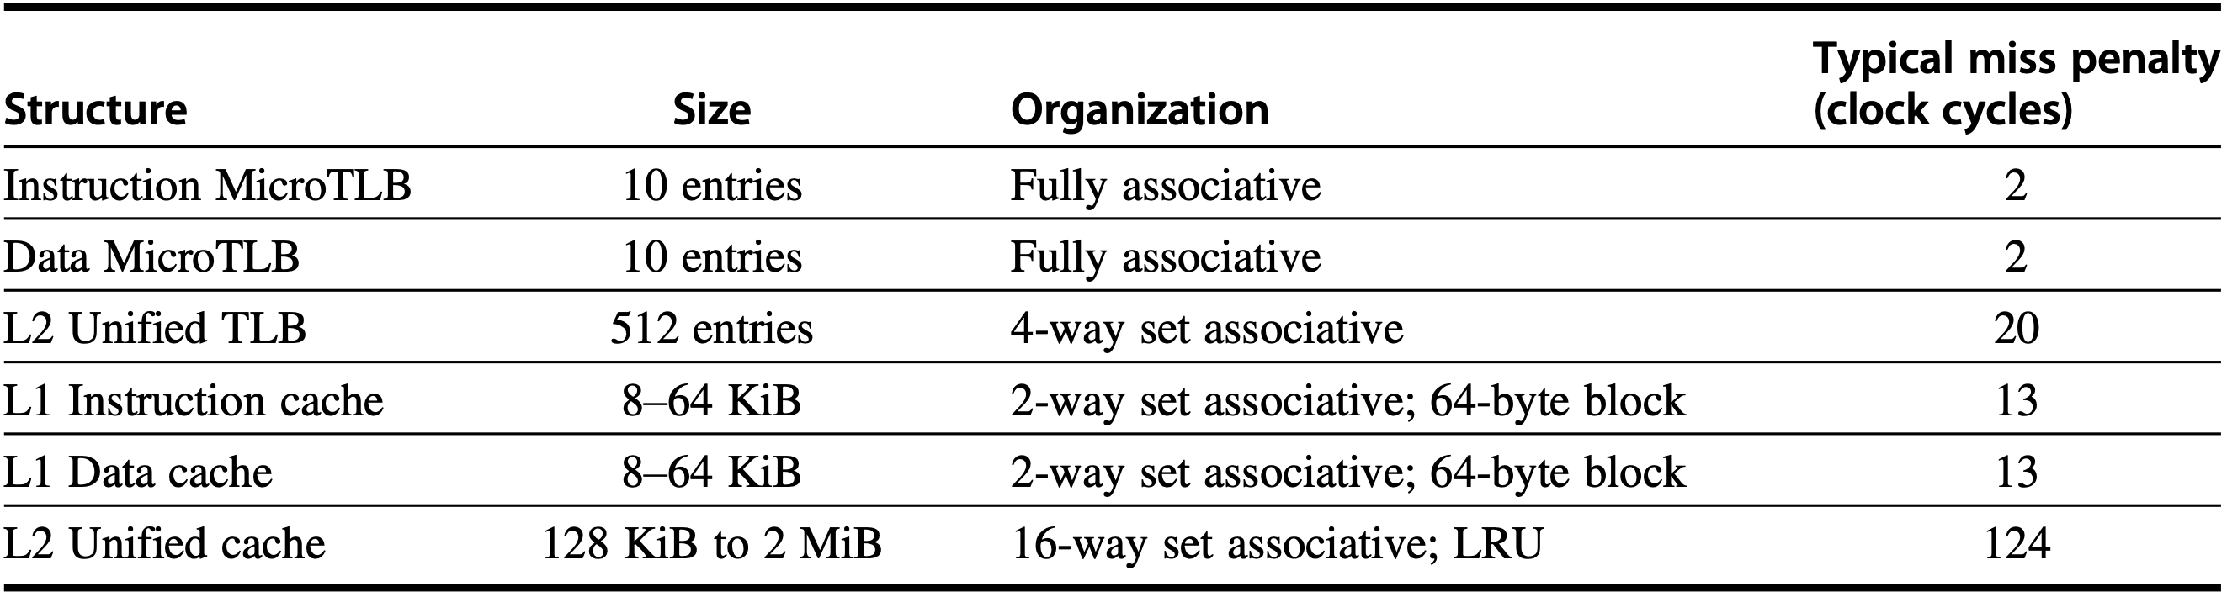
Memory Hierarchy
Two-level TLB
Two-level cache
LRU-approximation replacement policy
Notes:
Figure 2.19 The memory hierarchy of the Cortex A53 includes multilevel TLBs and caches. A page map cache keeps track of the location of a physical page for a set of virtual pages; it reduces the L2 TLB miss penalty. The L1 caches are virtually indexed and physically tagged; both the L1 D cache and L2 use a write-back policy defaulting to allocate on write. Replacement policy is LRU approximation in all the caches. Miss penalties to L2 are higher if both a MicroTLB and L1 miss occur. The L2 to main memory bus is 64–128 bits wide, and the miss penalty is larger for the narrow bus.

Slide 85
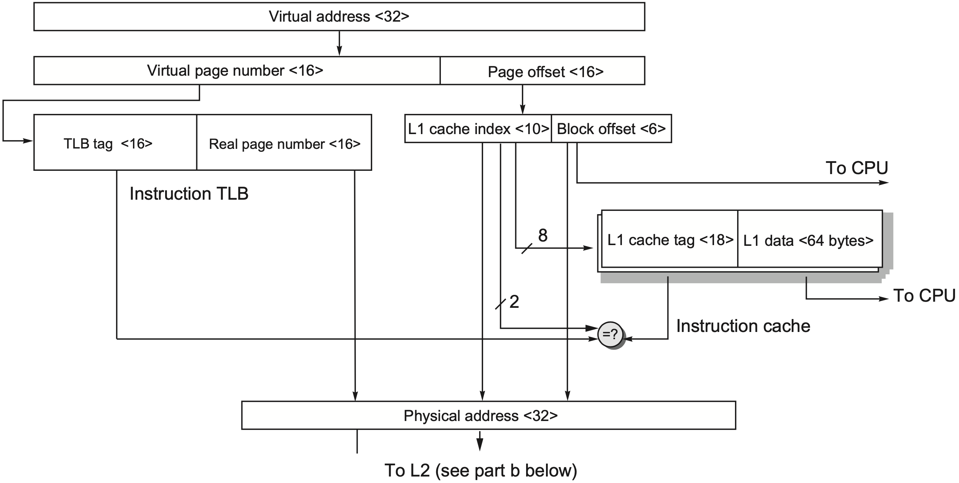
Instruction Access Path
Notes:
Figure2.20 Thevirtualaddress,physicalanddatablocksfortheARMCortex-A53cachesandTLBs,assuming32- bit addresses. The top half (A) shows the instruction access; the bottom half (B) shows the data access, including L2. The TLB (instruction or data) is fully associative each with 10 entries, using a 64 KiB page in this example. The L1 I- cache is two-way set associative, with 64-byte blocks and 32 KiB capacity; the L1 D-cache is 32 KiB, four-way set asso- ciative, and 64-byte blocks. The L2 TLB is 512 entries and four-way set associative. The L2 cache is 16-way set asso- ciative with 64-byte blocks and 128 cKiB to 2 MiB capacity; a 1 MiB L2 is shown. This figure doesn’t show the valid bits and protection bits for the caches and TLB.

Slide 86
Instruction Access Path
2¹⁶ = 64KB page

Slide 87
Instruction Access Path
16 = 32 -16
2¹⁶ = 64KB page

Slide 88
Instruction Access Path
16 = 32 -16
2¹⁶ = 64KB page
2⁶ = 64byte block

Slide 89
Instruction Access Path
16 = 32 -16
2¹⁶ = 64KB page
10 = 16 - 6
2⁶ = 64byte block

Slide 90
Instruction Access Path
16 = 32 -16
2¹⁶ = 64KB page
10 = 16 - 6
2⁶ = 64byte block
2⁸ = 32KB/(64B x 2)

Slide 91
Instruction Access Path
16 = 32 -16
2¹⁶ = 64KB page
10 = 16 - 6
2⁶ = 64byte block
2⁸ = 32KB/(64B x 2)
18 = 32 - 8 - 6

Slide 92
Instruction Access Path
16 = 32 -16
2¹⁶ = 64KB page
10 = 16 - 6
2⁶ = 64byte block
2⁸ = 32KB/(64B x 2)
18 = 32 - 8 - 6
Should RPN be compared with?
virtually indexed, physically tagged

Slide 93
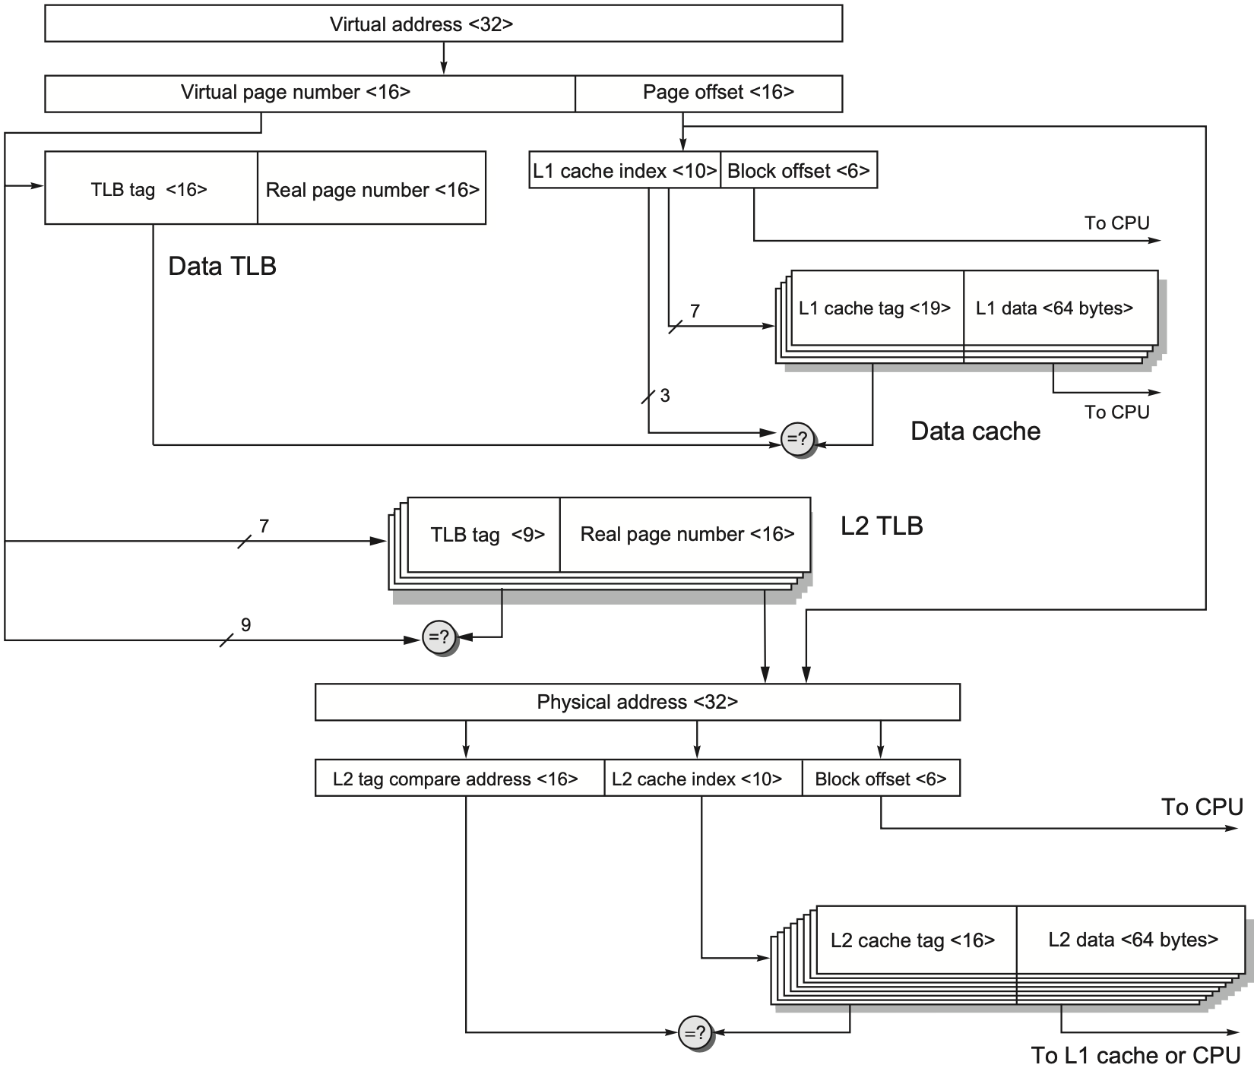
Data Access Path

Slide 94
Data Access Path
2¹⁶ = 64KB page

Slide 95
Data Access Path
16 = 32 -16
2¹⁶ = 64KB page

Slide 96
Data Access Path
16 = 32 -16
2¹⁶ = 64KB page
2⁶ = 64byte block

Slide 97
Data Access Path
16 = 32 -16
2¹⁶ = 64KB page
10 = 16 - 6
2⁶ = 64byte block

Slide 98
Data Access Path
16 = 32 -16
2¹⁶ = 64KB page
10 = 16 - 6
2⁶ = 64byte block
2⁷ = 32KB/(64B x 4)

Slide 99
Data Access Path
16 = 32 -16
2¹⁶ = 64KB page
10 = 16 - 6
2⁶ = 64byte block
2⁷ = 32KB/(64B x 4)
19 = 32 - 7 - 6

Slide 100
Data Access Path
16 = 32 -16
2¹⁶ = 64KB page
10 = 16 - 6
2⁶ = 64byte block
2⁷ = 32KB/(64B x 4)
19 = 32 - 7 - 6
Should RPN be compared with?
virtually indexed, physically tagged

Slide 101
Data Access Path
16 = 32 -16
2¹⁶ = 64KB page
10 = 16 - 6
2⁶ = 64byte block
2⁷ = 32KB/(64B x 4)
19 = 32 - 7 - 6
Should RPN be compared with?
virtually indexed, physically tagged
2⁷ = 512/4
Notes:
L1 TLB: 512 entries, 4-way set associative

Slide 102
Data Access Path
16 = 32 -16
2¹⁶ = 64KB page
10 = 16 - 6
2⁶ = 64byte block
2⁷ = 32KB/(64B x 4)
19 = 32 - 7 - 6
Should RPN be compared with?
virtually indexed, physically tagged
2⁷ = 512/4
9 = 16 - 7
Notes:
L1 TLB: 512 entries, 4-way set associative

Slide 103
Data Access Path
16 = 32 -16
2¹⁶ = 64KB page
10 = 16 - 6
2⁶ = 64byte block
2⁷ = 32KB/(64B x 4)
19 = 32 - 7 - 6
Should RPN be compared with?
virtually indexed, physically tagged
2⁷ = 512/4
9 = 16 - 7
16 = 32 - 10 - 6
2⁶ = 64byte block
2¹⁰ = 1MB/(64B x 16)
Notes:
L1 TLB: 512 entries, 4-way set associative

Slide 104
Performance
Instruction Cache: given 32 KiB primary caches and a 1 MiB L2 cache close to zero miss rate and under 1% for all of SPECInt2006 benchmarks
Notes:
32 KiB primary caches: 32 KiB instruction cache, 32 KiB data cache

Slide 105
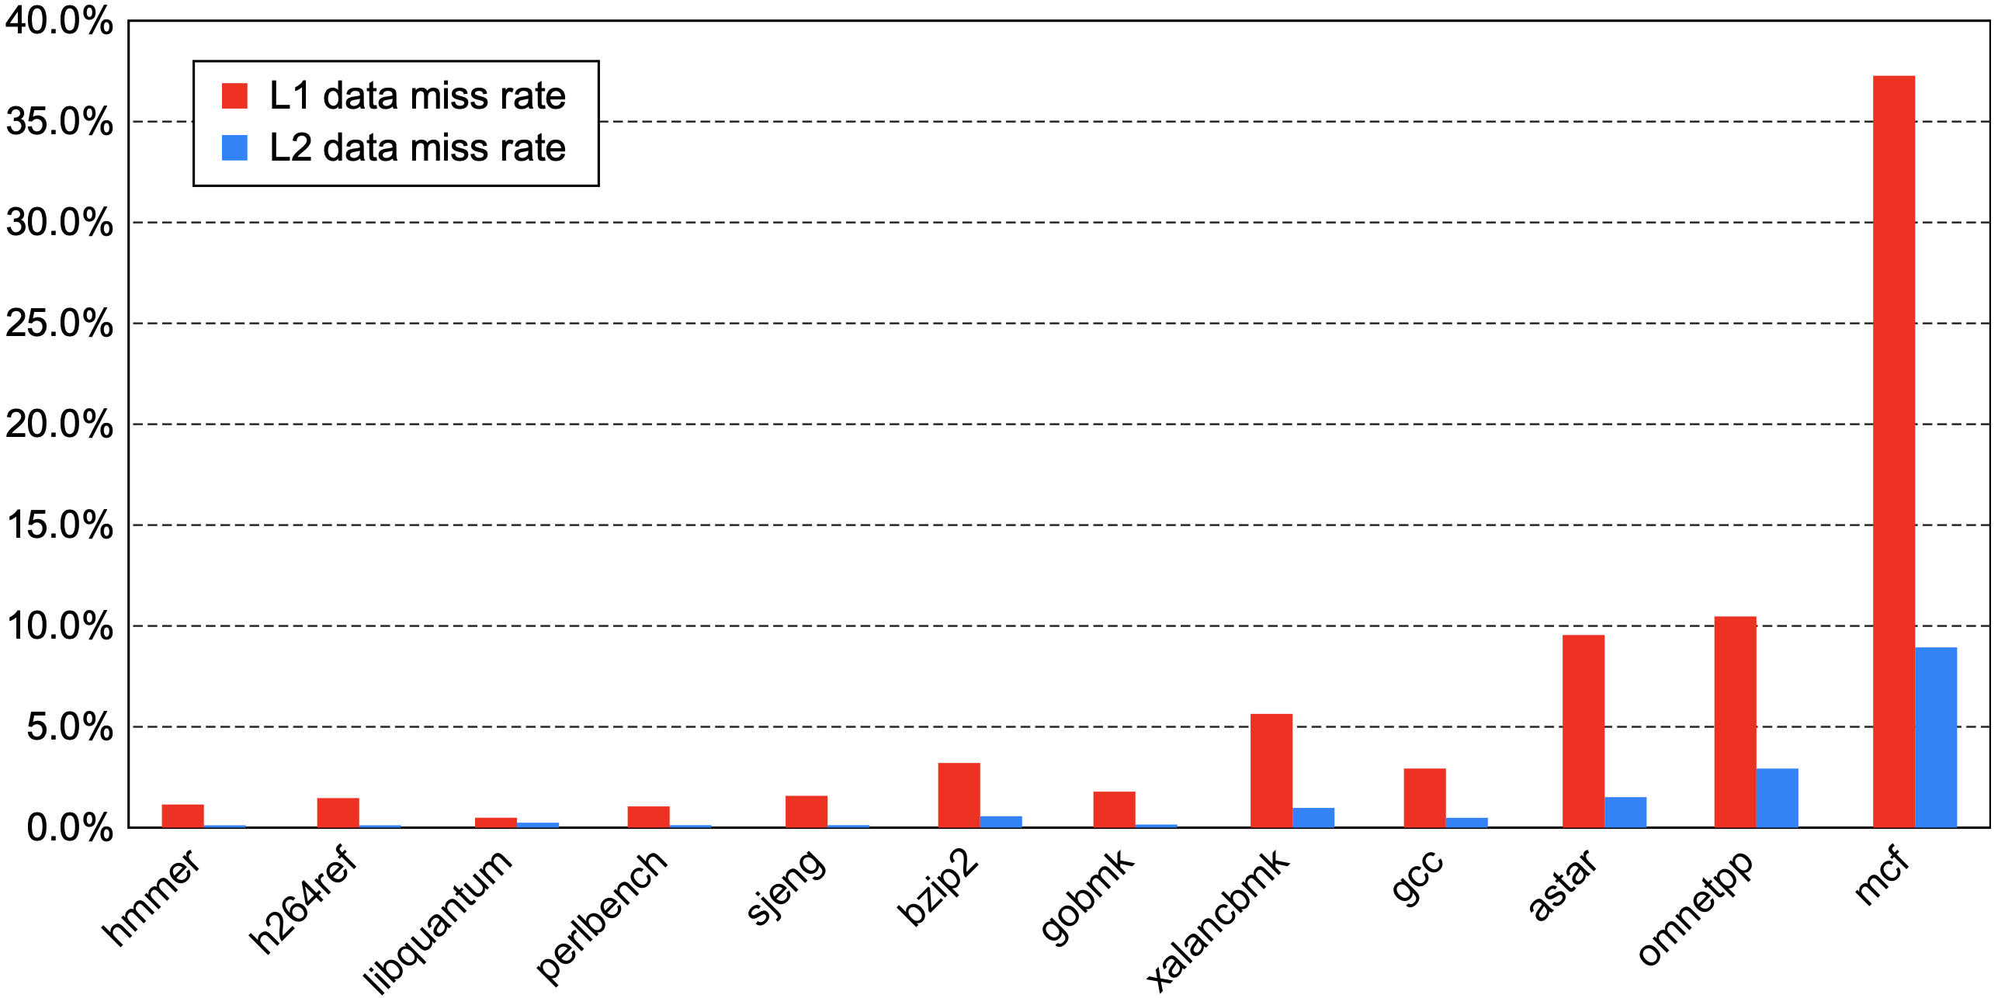
Performance
Data Cache: global miss rate

Slide 106
Performance
Data Cache: global miss rate
 | min | max | median
L1 | 0.5% | 37.3% | 2.4%
L2 | 0.05% | 9.0% | 0.3%

Slide 107
Performance
Miss Penalty

Slide 108
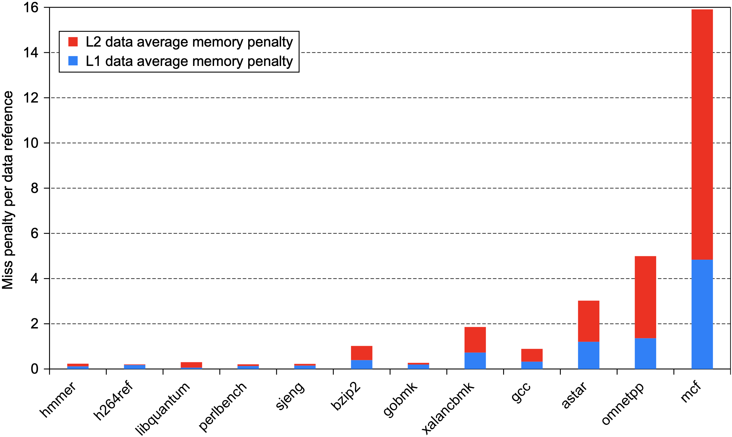
Performance
average penalty per data access

Slide 109
Intel Core i7-6700
64-bit x86-64 ISA
out-of-order 4-core processor
multiple issue, dynamically scheduled, 16-stage pipeline
up to 4 instructions per cycle per core

Slide 110
Intel Core i7-6700
64-bit x86-64 ISA
out-of-order 4-core processor
multiple issue, dynamically scheduled, 16-stage pipeline
up to 4 instructions per cycle per core
4.0 GHz
peak rate of 16 billion instructions per second per core

Slide 111
Intel Core i7-6700
up to 3 parallel memory channels
DDR3-1066
peak memory bandwidth of 25+ GB/S
48-bit virtual addresses
36-bit physical addresses → 36 GiB
two-level TLB

Slide 112
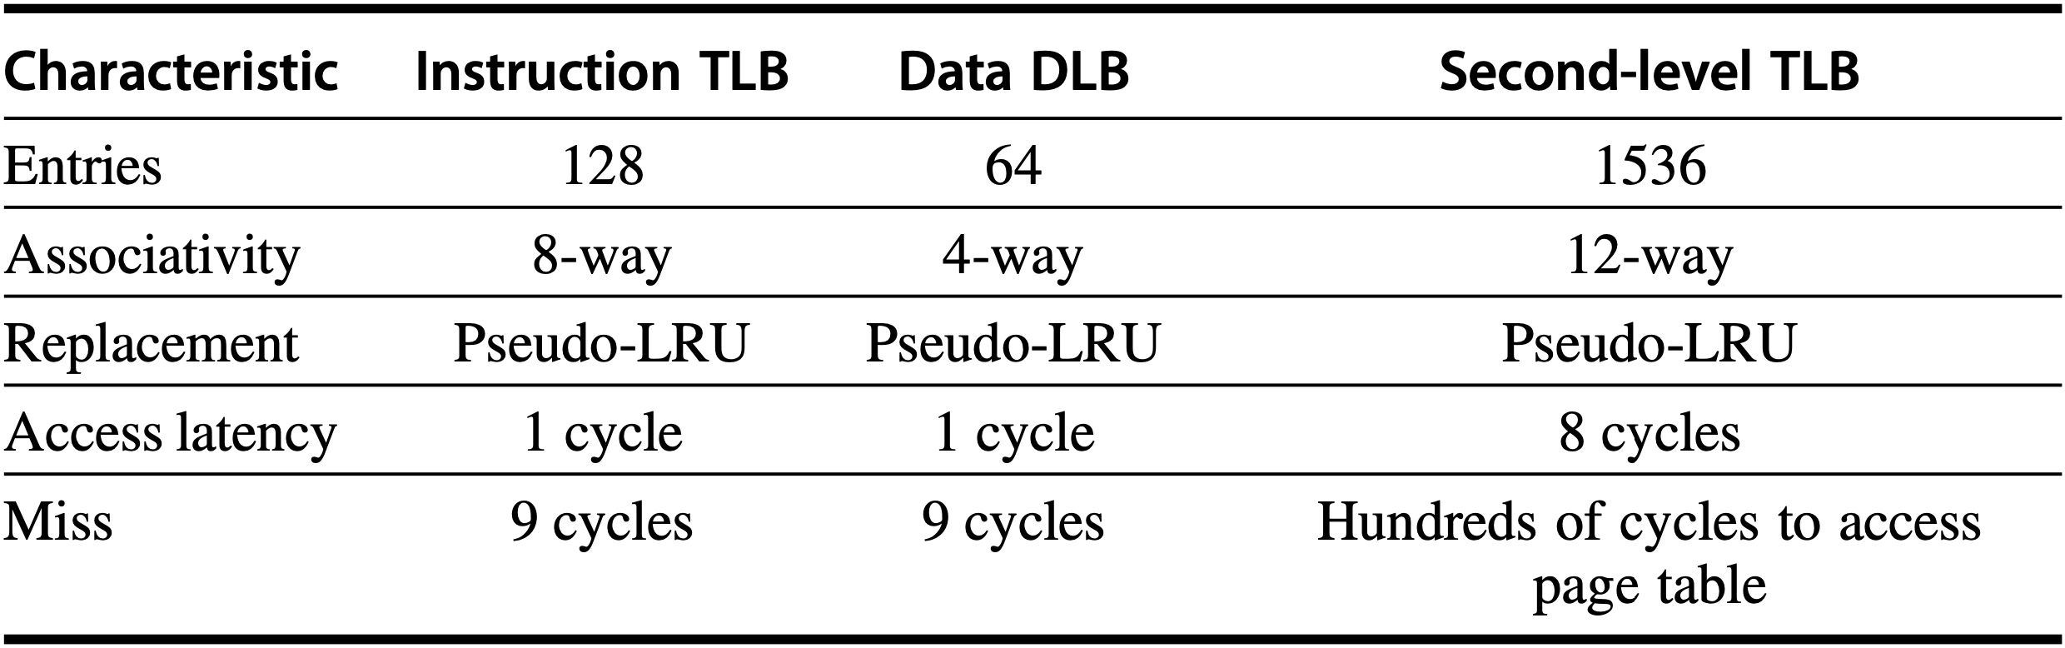
Intel Core i7-6700
48-bit virtual addresses
36-bit physical addresses → 36 GiB
two-level TLB
Notes:
Figure 2.23 Characteristics of the i7’s TLB structure, which has separate first-level instruction and data TLBs, both backed by a joint second-level TLB. The first-level TLBs support the standard 4 KiB page size, as well as having a limited number of entries of large 2–4 MiB pages; only 4 KiB pages are supported in the second-level TLB. The i7 has the ability to handle two L2 TLB misses in parallel. See Section L.3 of online Appendix L for more discussion of multilevel TLBs and support for multiple page sizes.

Slide 113
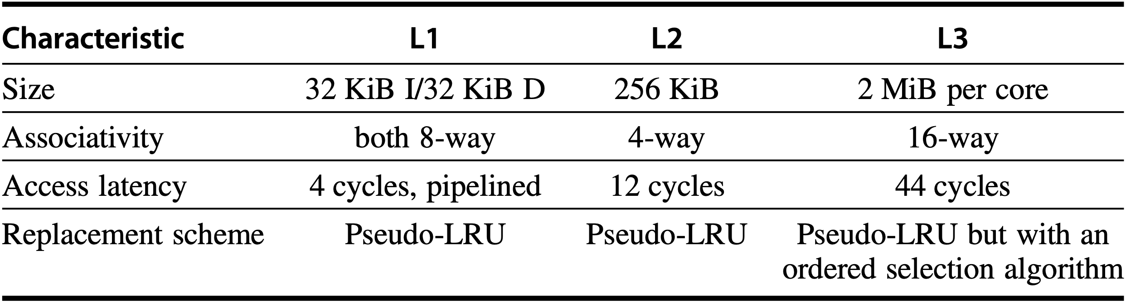
Intel Core i7-6700
three-level cache hierarchy
L1: virtually indexed & physically tagged
L2 & L3: physically indexed
Notes:
Figure 2.24 Characteristics of the three-level cache hierarchy in the i7. All three caches use write back and a block size of 64 bytes. The L1 and L2 caches are separate for each core, whereas the L3 cache is shared among the cores on a chip and is a total of 2 MiB per core. All three caches are nonblocking and allow multiple outstanding writes. A merging write buffer is used for the L1 cache, which holds data in the event that the line is not present in L1 when it is written. (That is, an L1 write miss does not cause the line to be allocated.) L3 is inclusive of L1 and L2; we explore this property in further detail when we explain multiprocessor caches. Replacement is by a variant on pseudo-LRU; in the case of L3, the block replaced is always the lowest numbered way whose access bit is off. This is not quite random but is easy to compute.

Slide 114
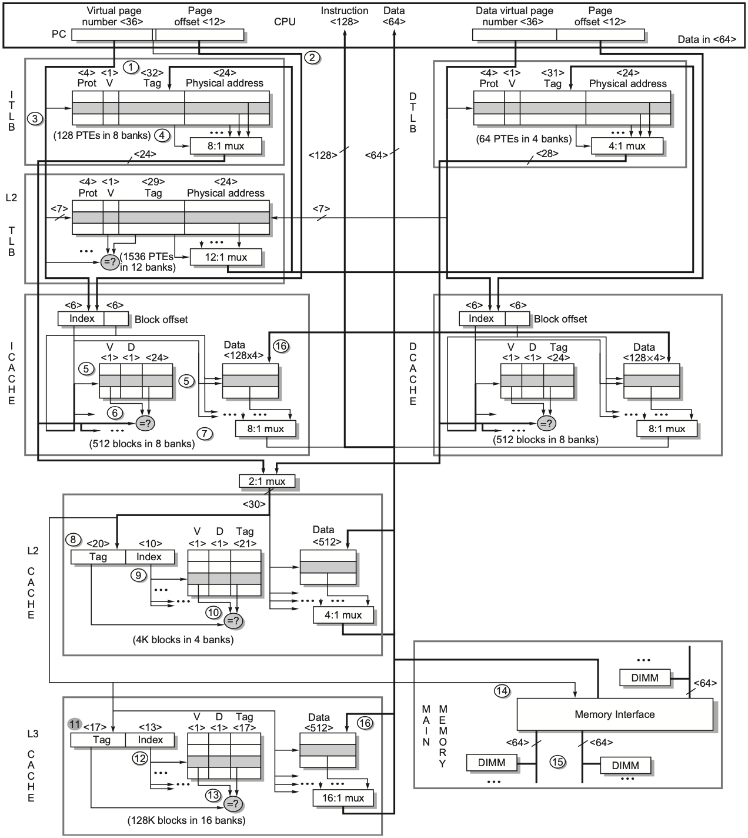
Memory Access P134-137
Notes:
Figure2.25 TheInteli7memoryhierarchyandthestepsinbothinstructionanddataaccess.Weshowonlyreads. Writes are similar, except that misses are handled by simply placing the data in a write buffer, because the L1 cache is not write-allocated.

Slide 115
Memory Access P134-137
32? 36 – log(64/4)
24?
20? (21 in 5th edition as 21-bit tag + 9-bit index)
Notes:
Figure2.25 TheInteli7memoryhierarchyandthestepsinbothinstructionanddataaccess.Weshowonlyreads. Writes are similar, except that misses are handled by simply placing the data in a write buffer, because the L1 cache is not write-allocated.

Slide 116
Performance
L1 Instruction Cache: given 32 KiB, 8-way set associative instruction cache fetch 16 bytes every cycle (roughly 4.5 instructions on average) under 1% miss rates for most of SPECInt2006 benchmarks 2.9% miss rate for XALANCBMK

Slide 117
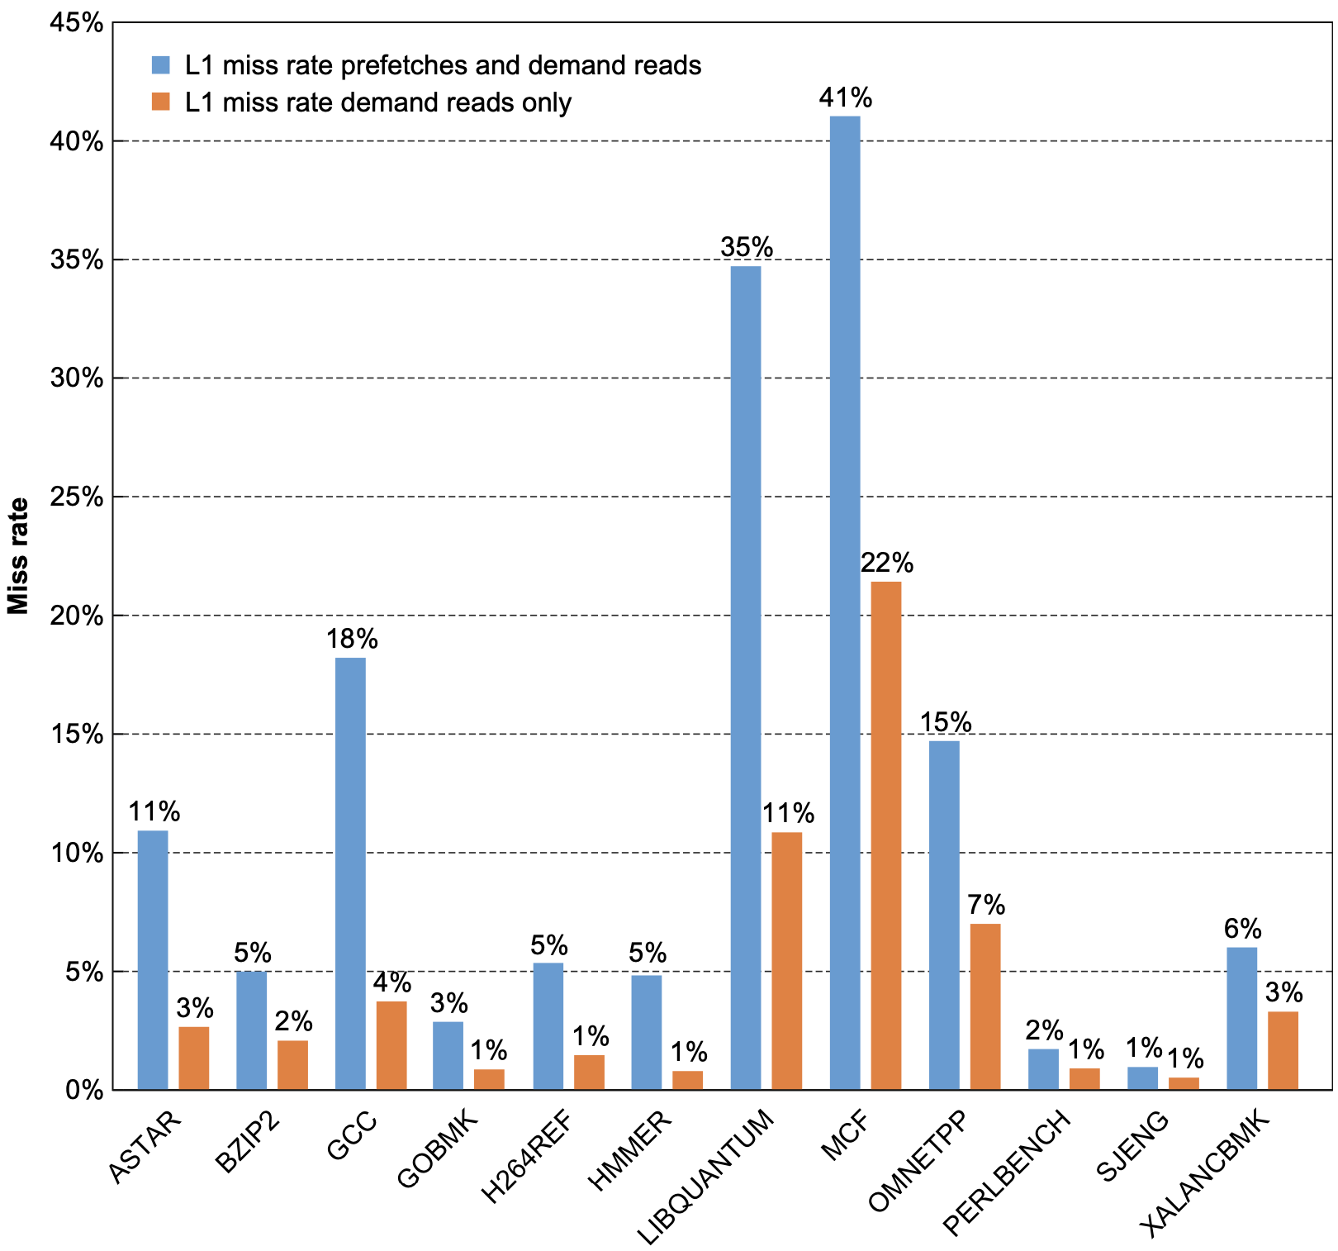
Performance
L1 Data Cache: miss rate
Notes:
Figure 2.26 The L1 data cache miss rate for the SPECint2006 benchmarks is shown in two ways relative to the demand L1 reads: one including both demand and prefetch accesses and one including only demand accesses. The i7 separates out L1 misses for a block not present in the cache and L1 misses for a block already outstanding that is being prefetched from L2; we treat the latter group as hits because they would hit in a blocking cache. These data, like the rest in this section, were collected by Professor Lu Peng and PhD student Qun Liu, both of Louisiana State University, based on earlier studies of the Intel Core Duo and other processors (see Peng et al., 2008).

Slide 118
Performance
L1 Data Cache: miss rate
Demand access: cache access generated because of an actual instruction access or data access
Prefetch access
Notes:
Figure 2.26 The L1 data cache miss rate for the SPECint2006 benchmarks is shown in two ways relative to the demand L1 reads: one including both demand and prefetch accesses and one including only demand accesses. The i7 separates out L1 misses for a block not present in the cache and L1 misses for a block already outstanding that is being prefetched from L2; we treat the latter group as hits because they would hit in a blocking cache. These data, like the rest in this section, were collected by Professor Lu Peng and PhD student Qun Liu, both of Louisiana State University, based on earlier studies of the Intel Core Duo and other processors (see Peng et al., 2008).

Slide 119
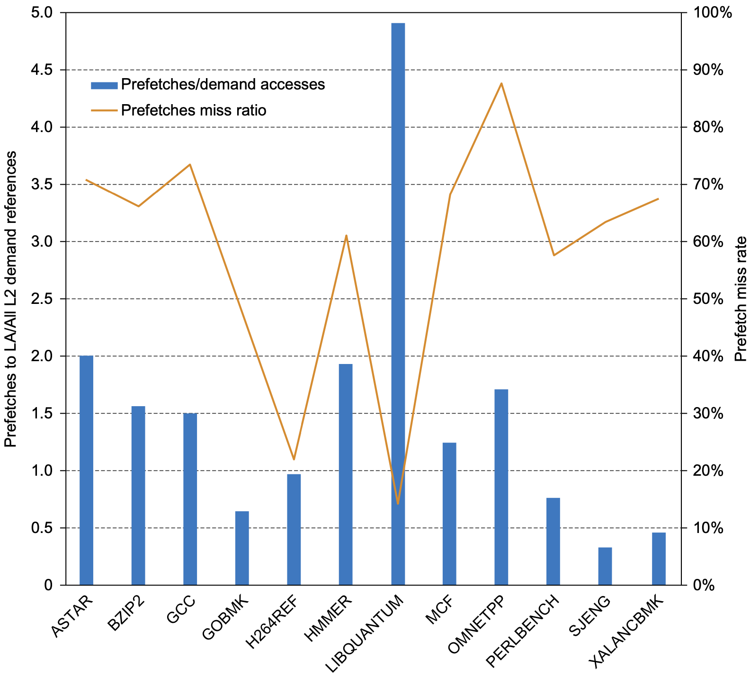
Performance
Prefetching
Notes:
Figure 2.27 The fraction of L2 requests that are prefetches is shown via the columns and the left axis. The right axis and the line shows the prefetch hit rate. These data, like the rest in this section, were collected by Professor Lu Peng and PhD student Qun Liu, both of Louisiana State University, based on earlier studies of the Intel Core Duo and other processors (see Peng et al., 2008).

Slide 120
Performance
Prefetching: 1.5 times as many prefetches as there are L2 demand requests prefetch miss rate of 58% on average
Notes:
To understand the effectiveness of the aggressive prefetch mechanisms in the i7, let’s look at some measurements of prefetching. Figure 2.27 shows both the fraction of L2 requests that are prefetches versus demand requests and the prefetch miss rate. The data are probably astonishing at first glance: there are roughly 1.5 times as many prefetches as there are L2 demand requests, which come directly from L1 misses. Furthermore, the prefetch miss rate is amazingly high, with an average miss rate of 58%. Although the prefetch ratio varies considerably, the pre- fetch miss rate is always significant. At first glance, you might conclude that the designers made a mistake: they are prefetching too much, and the miss rate is too high. Notice, however, that the benchmarks with the higher prefetch ratios (ASTAR, BZIP2, HMMER, LIBQUANTUM, and OMNETPP) also show the greatest gap between the prefetch miss rate and the demand miss rate, more than a factor of 2 in each case. The aggressive prefetching is trading prefetch misses, which occur earlier, for demand misses, which occur later; and as a result, a pipe- line stall is less likely to occur due to the prefetching.

Slide 121
Performance
Prefetching: 1.5 times as many prefetches as there are L2 demand requests prefetch miss rate of 58% on average
Why so aggressive prefetching?
Notes:
To understand the effectiveness of the aggressive prefetch mechanisms in the i7, let’s look at some measurements of prefetching. Figure 2.27 shows both the fraction of L2 requests that are prefetches versus demand requests and the prefetch miss rate. The data are probably astonishing at first glance: there are roughly 1.5 times as many prefetches as there are L2 demand requests, which come directly from L1 misses. Furthermore, the prefetch miss rate is amazingly high, with an average miss rate of 58%. Although the prefetch ratio varies considerably, the pre- fetch miss rate is always significant. At first glance, you might conclude that the designers made a mistake: they are prefetching too much, and the miss rate is too high. Notice, however, that the benchmarks with the higher prefetch ratios (ASTAR, BZIP2, HMMER, LIBQUANTUM, and OMNETPP) also show the greatest gap between the prefetch miss rate and the demand miss rate, more than a factor of 2 in each case. The aggressive prefetching is trading prefetch misses, which occur earlier, for demand misses, which occur later; and as a result, a pipe- line stall is less likely to occur due to the prefetching.

Slide 122
Performance
Prefetching: 1.5 times as many prefetches as there are L2 demand requests prefetch miss rate of 58% on average
Why so aggressive prefetching? trade prefetch misses for demand misses mitigate pipeline stalls
Notes:
Similarly, consider the high prefetch miss rate. Suppose that the majority of the prefetches are actually useful (this is hard to measure because it involves tracking individual cache blocks), then a prefetch miss indicates a likely L2 cache miss in the future. Uncovering and handling the miss earlier via the prefetch is likely to reduce the stall cycles. Performance analysis of speculative superscalars, like the i7, has shown that cache misses tend to be the primary cause of pipeline stalls, because it is hard to keep the processor going, especially for longer running L2 and L3 misses. The Intel designers could not easily increase the size of the caches with- out incurring both energy and cycle time impacts; thus the use of aggressive pre- fetching to try to lower effective cache miss penalties is an interesting alternative approach.

Slide 123
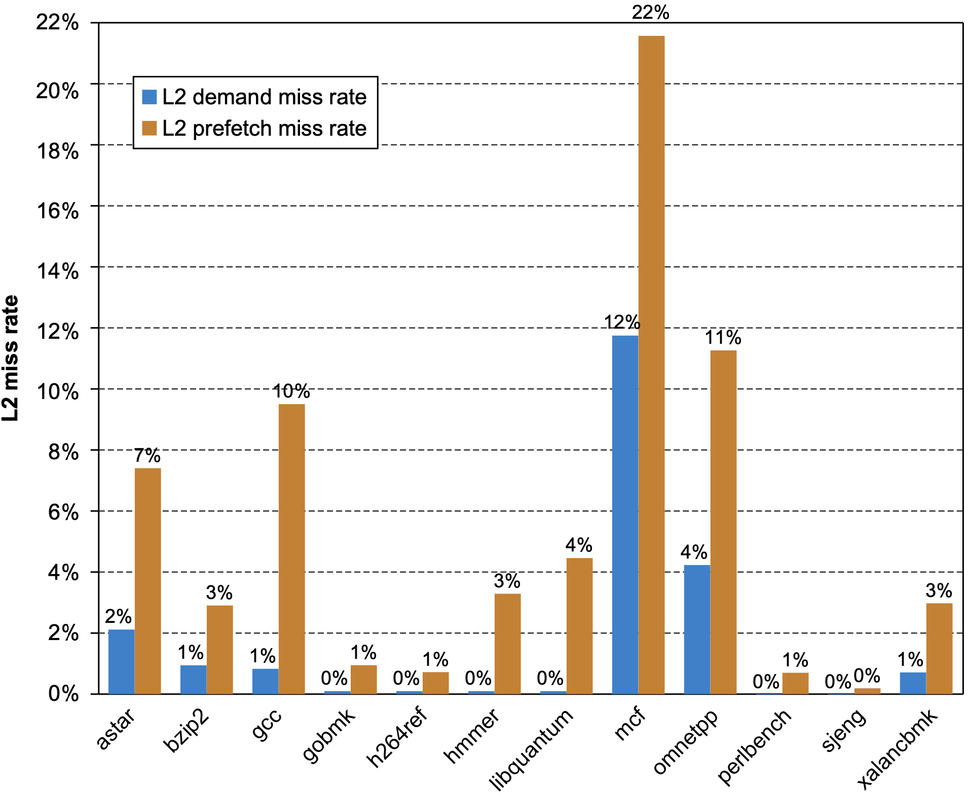
Performance
L2 Cache: miss rate 75% of L2 misses are prefetch misses average miss rate >7%
Notes:
Figure2.28 TheL2demandmissrateandprefetchmissrate,bothshownrelativeto all the references to L1, which also includes prefetches, speculative loads that do not complete, and program-generated loads and stores (demand references). These data, like the rest in this section, were collected by Professor Lu Peng and PhD student Qun Liu, both of Louisiana State University.

Slide 124
Performance
L2 Cache: miss rate 75% of L2 misses are prefetch misses average miss rate >7%
L3 Cache: miss rate average miss rate ~0.5%
Notes:
Because the cost for a miss to memory is over 100 cycles and the average data miss rate in L2 combining both prefetch and demand misses is over 7%, L3 is obvi- ously critical. Without L3 and assuming that about one-third of the instructions are loads or stores, L2 cache misses could add over two cycles per instruction to the CPI! Obviously, prefetching past L2 would make no sense without an L3.
In comparison, the average L3 data miss rate of 0.5% is still significant but less than one-third of the L2 demand miss rate and 10 times less than the L1 demand miss rate. Only in two benchmarks (OMNETPP and MCF) is the L3 miss rate above 0.5%; in those two cases, the miss rate of about 2.3% likely dominates all other performance losses.

Slide 125
more on
performance measurement

Slide 126
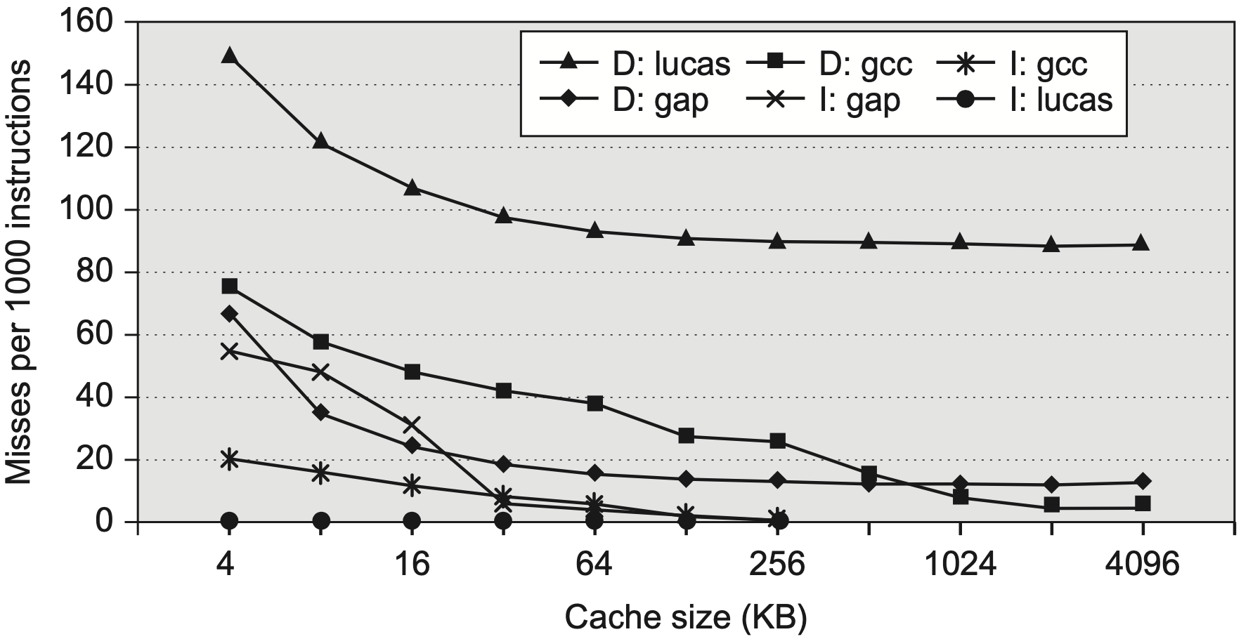
Why Many Benchmarks?
No single program represents all
Notes:
Figure 2.29 Instruction and data misses per 1000 instructions as cache size varies from 4 KiB to 4096 KiB. Instruction misses for gcc are 30,000–40,000 times larger than for lucas, and, conversely, data misses for lucas are 2–60 times larger than for gcc. The programs gap, gcc, and lucas are from the SPEC2000 benchmark suite.

Slide 127
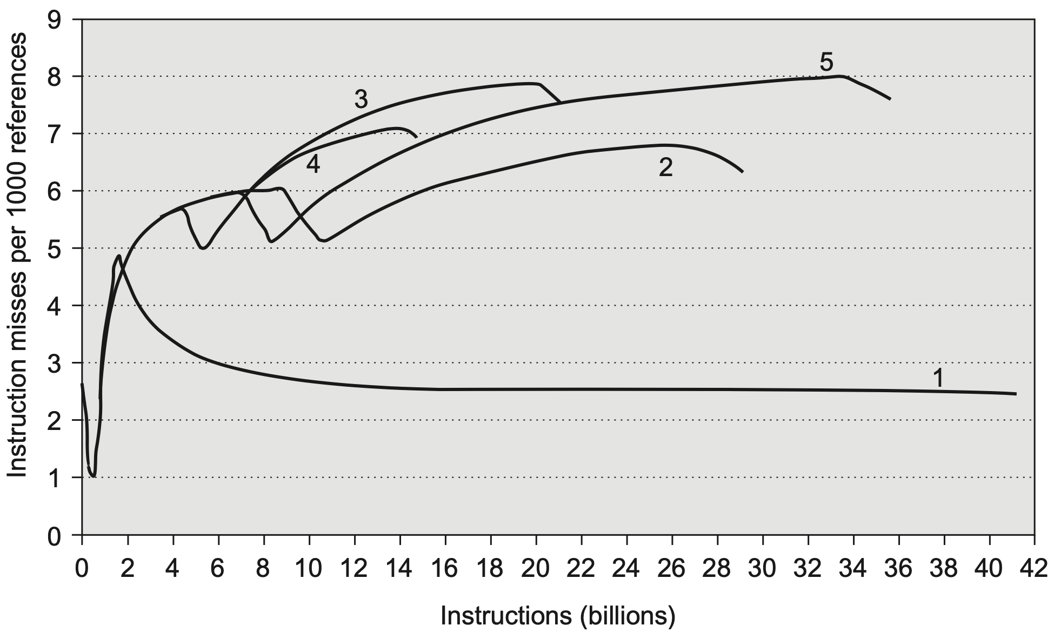
Why Even More Instructions?
Miss rate varies much over program lifetime
Notes:
Figure2.30 Instructionmissesper1000referencesforfiveinputstotheperlbench- mark in SPEC2000. There is little variation in misses and little difference between the five inputs for the first 1.9 billion instructions. Running to completion shows how misses vary over the life of the program and how they depend on the input. The top graph shows the running average misses for the first 1.9 billion instructions, which starts at about 2.5 and ends at about 4.7 misses per 1000 references for all five inputs. The bot- tom graph shows the running average misses to run to completion, which takes 16–41 billion instructions depending on the input. After the first 1.9 billion instructions, the misses per 1000 references vary from 2.4 to 7.9 depending on the input. The simulations were for the Alpha processor using separate L1 caches for instructions and data, each being two-way 64 KiB with LRU, and a unified 1 MiB direct-mapped L2 cache.

Slide 128
Appendix B
Chapter 2.3-2.7
Notes:
The following content corresponds to chapter 2 (mostly 2.1 – 2.4)
atop the basic working principles of memory hierarchy we have learnt from Appendix B.

Slide 129
?

Slide 130

Thank You
be consistent

Slide 131

be consistent
gently, but firmly

Slide 132
#What’s More
The Story of Xiaoyan
Peaceful Warrior
“Old urges continue to arise, but urges do not matter; only actions do. A warrior is as a warrior does.”

